Slide 1
Congregational Singing, Knowledge Transfer, Identity
Hungarian-Language Congregational Singing
in the 16th Century
SZATMÁRI Áron
Institute for Literary Studies, Research Centre for the Humanities

Slide 2
Magyar Irodalomtörténet, 1. kötet
Hungarian Literary History, vol. 1
ii. Literature of the Hungarian Renaissance, 1540–1640
A) Religious literature
3. Genres of collective and individual religiosity
– The poetic and prose genres of liturgy

Slide 3
History of Congregational Singing: Printed Hymnbooks
Reformation period (Protestant hymnals, 1536–1566)
Period of confessionalization (denominational hymnals,
1569–1642)
Period of Pan-Protestant hymnals (1635–1700)
Age of denominational hymnals (from the end of the
17th century).

Slide 4
Period 1: Protestant hymnals
Kraków, 1536, 1538: István GÁLSZÉCSI
Magyaróvár – Košice/Kassa – Debrecen, 1560–61: Gál HUSZÁR
Debrecen, 1563: Péter MELIUS JUHÁSZ (fragment)
Oradea/Várad, 1566: the editor is unknown

Slide 5
Period 2 / Lutheran hymnals
Komjatice/Komjáti, 1574: Gál HUSZÁR (gradual hymnbook)
Plavecké Podhradie/Detrekő, 1582: Péter BORNEMISZA
Eberau/Monyorókerék, around 1590 (fragment)
Bardejov/Bártfa, 1593: the editor is unknown

Slide 6
Period 2 / Reformed hymnals
Debrecen, 1569, 1570, 1572, around 1579, 1586, 1590
Debrecen, 1602: Imre ÚJFALVI

Slide 7
Period 2 / Reformed hymnals
Debrecen, 1569, 1570, 1572, around 1579, 1586, 1590
Debrecen, 1602: Imre ÚJFALVI
Period 3
Levoča/Lőcse, 1635: Protestant hymnal

Slide 8
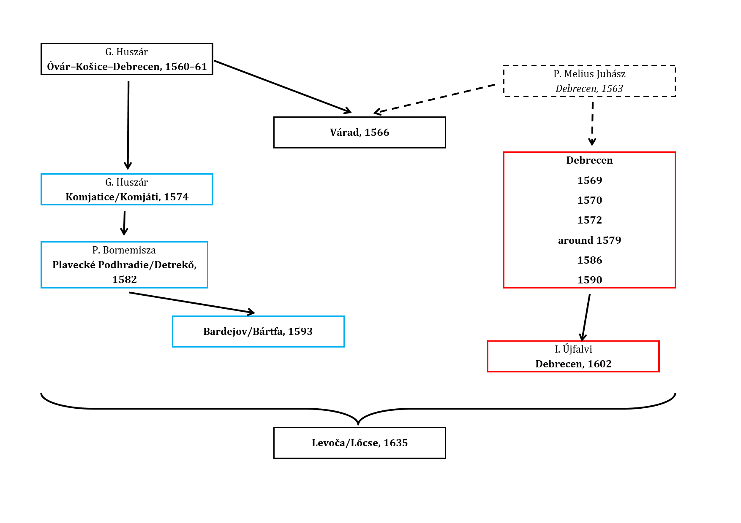

Slide 9
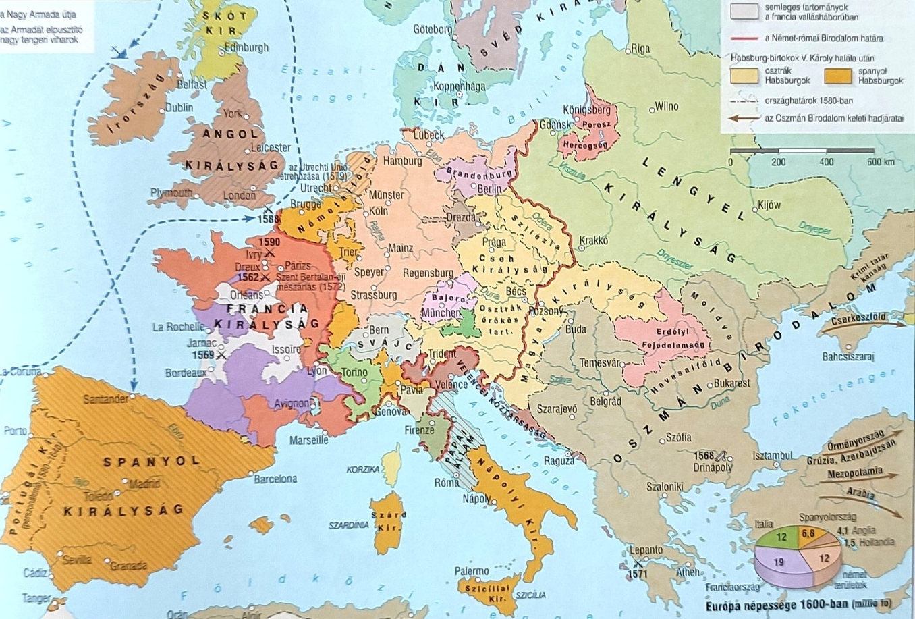

Slide 10
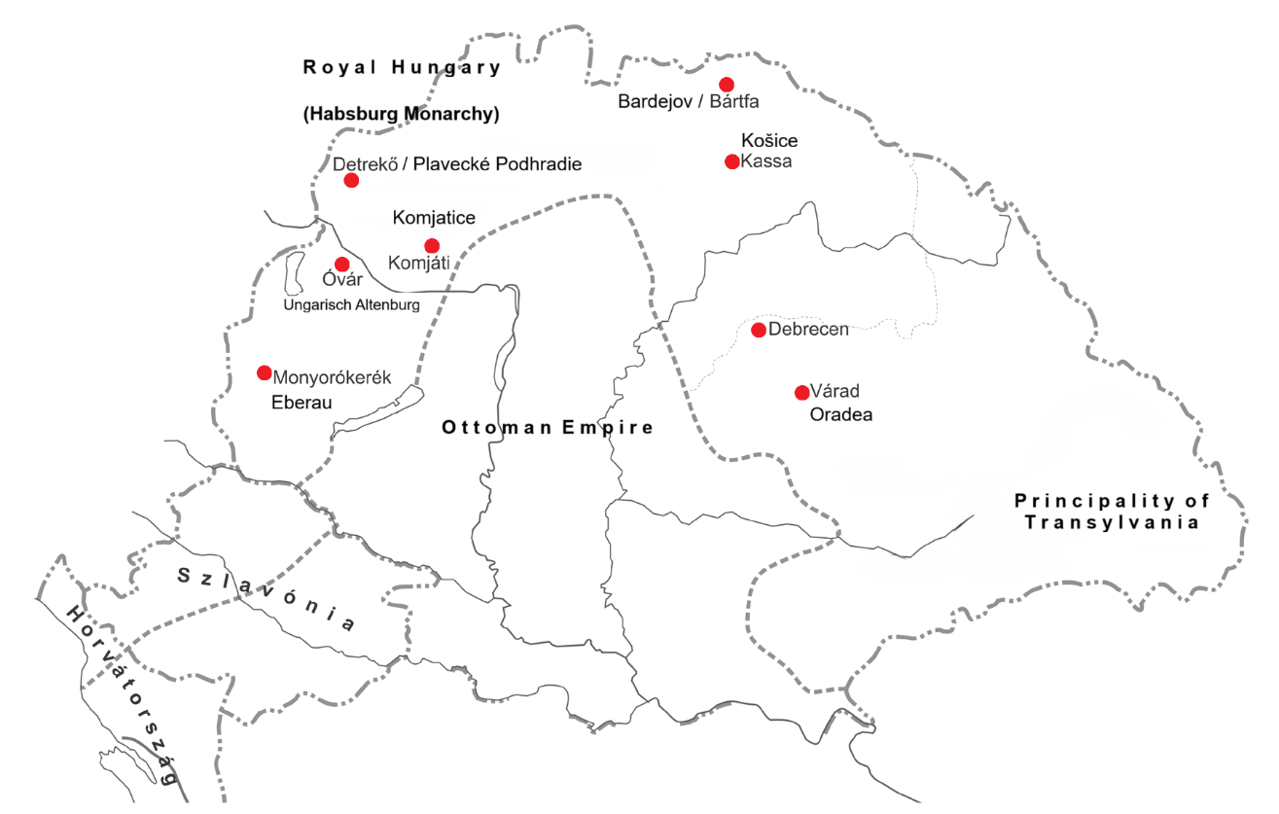

Slide 11
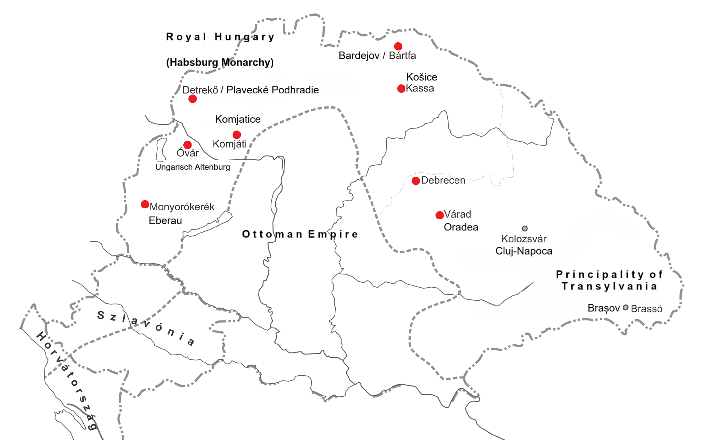
Gál Huszár’s equipment
The printing house of Debrecen

Slide 12
Gál Huszár’s equipment
(3 editions)
1 edition
The printing house of Debrecen (9 editions)
1 edition
0 edition

Slide 13
Upper Hungary
Debrecen

Slide 14
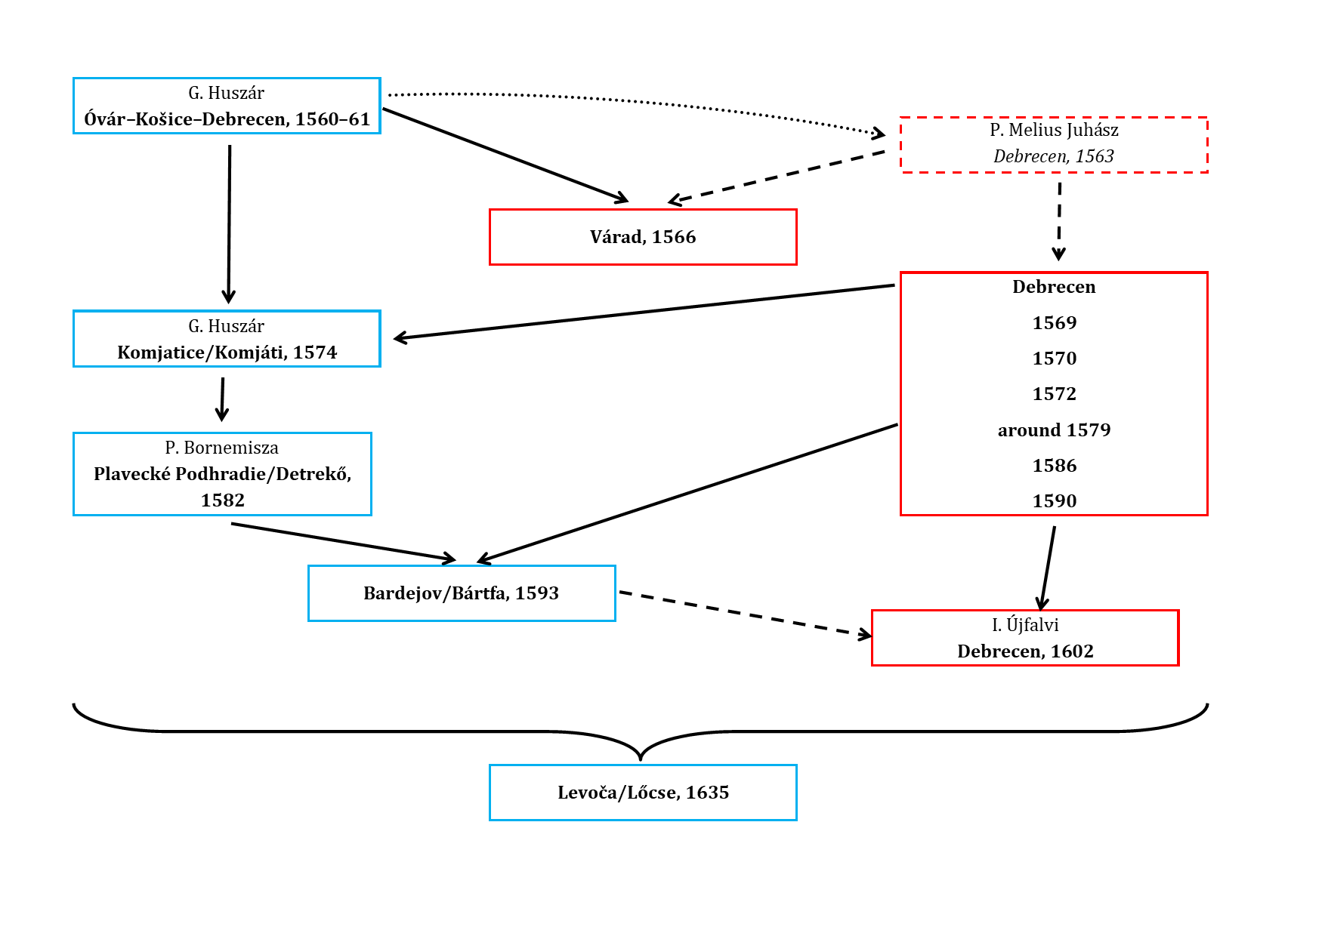

Slide 15
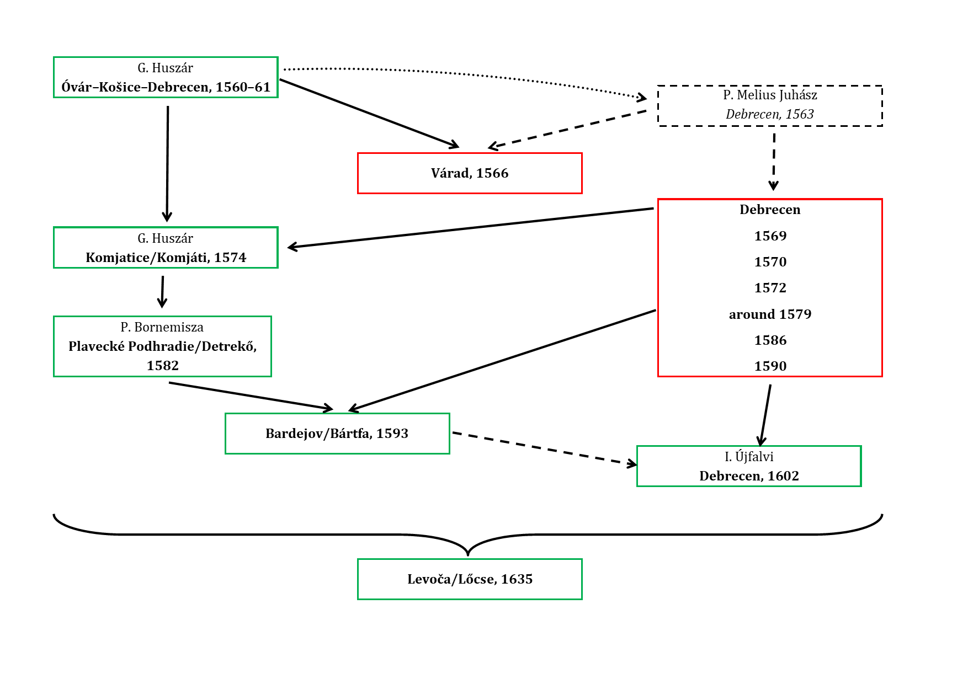
Editions with greater investment
Reproduction/reissue model

