Slide 1
Jesuit school teachers of the Austrian Jesuit province in the second half of the 16th century
Dmitry Zharov
(CEU, Vienna)

Slide 2
The noblest duty?
“The teacher could look upon himself as a crafter of musical instruments,
and upon the school as his workshop: it is where pipes have to be made of various
sizes and so equipped that they might be splendid and pleasant in appearance while
they are capable of producing harmonious sounds in churches-music that people
like and that is most appealing to God <…>
He may think of himself as a painter, engraver, or sculptor set upon these
works, to make images of Christ the Lord, living ones, ones that will last forever,
ones that are to be set up in the plaza and in the heavenly temple, where, in that light
and in the midst of that great crowd of the saints, the talent and care and skill of the
craftsman are always going to be on display together.”.
(Franceso Sacchini, Advice for the Teachers of Young Students. 1625)

Slide 3
Jesuit school teachers
Teachers of preparatory classes (infimistae), Grammar, Humanities (Humanitas/Poesis) and Rhetoric.
“Invisible” drivers and promoters of pedagogical and confessional changes
“Here pride does not lay a trap with the applause of crowds, nor does ambition blind the eyes with the loftiness of a command-post..” (Franceso Sacchini, Exhortation for the Teachers of Young Students. 1625)
Teaching the majority of students in the Jesuit educational system
Often undesirable occupation
Francesco Sacchini’s treatises Protrepticon and Paraenesis as response to existing problems

Slide 4
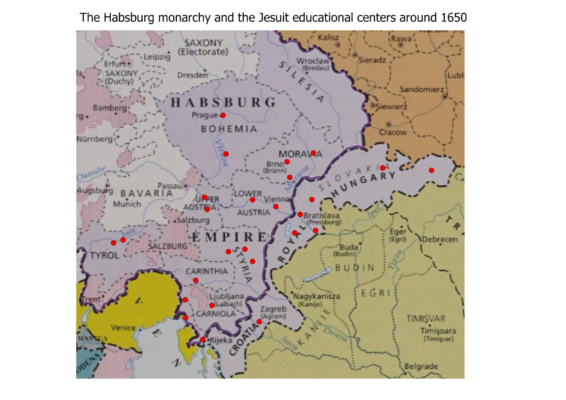
1551 – the first Jesuit college in Vienna
1566 – the college in Olomouc. From 1573 – University
1574 – the college in Graz. From 1586 – University.
Jesuit teachers as key promoters of re-Catholization in the confessionally heterogenous territories.
Who were those teachers?
What problems did they face?
What was expected from them?
Did they fulfill the expectations?

Slide 5
Sources
Catalogi personarum. The most important prospographical source. Origin, age, career path within the Society of Jesus, comments on health conditions, personal quality and professional skills of the college members.
College chronicles
Visitation reports
Theoretical treatises on the role of teachers (Sacchini’s “Advice” and “Exhortation”)

Slide 6
School teachers within the Jesuit college community
Sacerdotes
(priests, the most important members)
Coadjutores temporales
Praeceptores (school teachers) 5-8 teachers in a single year. 12-15%
Scholastici (students of one of the disciplines)
Novitii

Slide 7
Origin
Locals constituted the minority of teachers
Common trend for the entire Jesuit college community. Slow recruitment of locals in the first decades after the foundation of the colleges.
The biggest groups both in Vienna and Graz: German lands of the Holy Roman Empire and Flandres.
In Graz more teachers from Inner Austria
In Vienna more diverse regional composition: Italians, Hungarians, Poles, Spaniards, English

Slide 8
Teachers were usually young. Average age – 26 years old.
High rotation rates, short periods of teaching the same discipline. Averagely 2-3 years followed by advancement to a higher class
Exceptions related to inaptitude for the more advanced teaching or other duties (mostly due to health problems)
Switching from teaching to other tasks (missionary work, administrative duties in the college, preaching)
Constant circulation between different colleges. Colleges within the Austrian province (Prague, Olomouc, Tyrnava), Ingolstadt, Rome.
Teachers of lower classes were often simultaneously students in the higher ones (Philosophy, Theology)
Mostly trained in the Jesuit educational system but some teachers completed part of their education outside of the Society (extra Societatem).

Slide 9
Promoting piety and religious discipline
Sacchini stressed the role of teachers as promoters of religious ideas
Explanation of the catechism once a week. Competition among students
Private conversations on religious matters
Developing proper religious habits (frequently receiving the sacraments and attending daily Mass)
Common prayers
Teachers serving as prefects in the dormitories.
Monitoring domestic discipline

Slide 10
Teachers and town communities
Teachers were main mediators between the school and the urban comminutes
Frequent communication with parents
Building the reputation of the Society of Jesus in towns through the excellency in teaching.
Attacks against teachers by burghers. Murder attempt in Vienna in 1560
Religious indoctrination of parents via children. “ With you, they [children] are students; but with their parents they are teachers” (Franceso Sacchini, Exhortation for the Teachers of Young Students. 1625)

Slide 11
Problems on the ground
Language barriers.
“It will bring great advantage if, as often as possible, the teacher first thinks out carefully at home in Latin (as it stands in the rules) what he is going to dictate in the local language; then, he should translate this into vernacular form, again writing out a good corrected version, so that the pupils will be learning both languages equally” (Sacchini, Advice for the Young Teachers, Ch.7).
Recurrent concerns about the lack of language proficiency in the visitation reports. Stress on language skills in the evaluation of College members’ qualifications in the Catalogi.
Classes not always properly conducted and teachers sufficiently trained. Visitation report from Vienna 1583: teacher give very few written compositions and organize not enough disputes and other oral exercises.
Overstraining of teachers. Student-teacher ratio 50:1 in the rhetoric class in Olomouc in 1581
Distraction by other duties in the College

Slide 12
A defecting teacher
Caspar Kratzer. Born in Ulm to Protestant parents, converted to Catholicism, entered the Society of Jesus, studied in Prague and Vienna
1575-1578 – Grammar teacher in Vienna
1578 – Defection
Becoming Lutheran preacher. Professor at the Protestant Stiftsschule in Graz
Preacher in Spiš region
Inspired by two other defectors who were professors of Theology and Philosophy

Slide 13
Conclusion
Pillars of the Jesuit educational order
Responsible for pedagogical and confessional tasks
Mediators between schools and local communities
Young, unexperienced, not locals
High turnover, overwork, insufficient training, language barriers
Ambiguous religious allegiance of some teachers
Efficiency limits of Jesuit schools as teaching and conversion centeres

