Slide 1
Gyulafehérvár, Kolozsvár, Marosvásárhely – A Curriculum's Journey from Planning to Implementation and Beyond
Annamária Kimpián
Teleki-Bolyai Library
Târgu Mureș / Marosvásárhely
Transfer of Knowledge and Scholarship in the academic world of Early modern Central Europe
Prešov, 16-17. sept. 2025

Slide 2
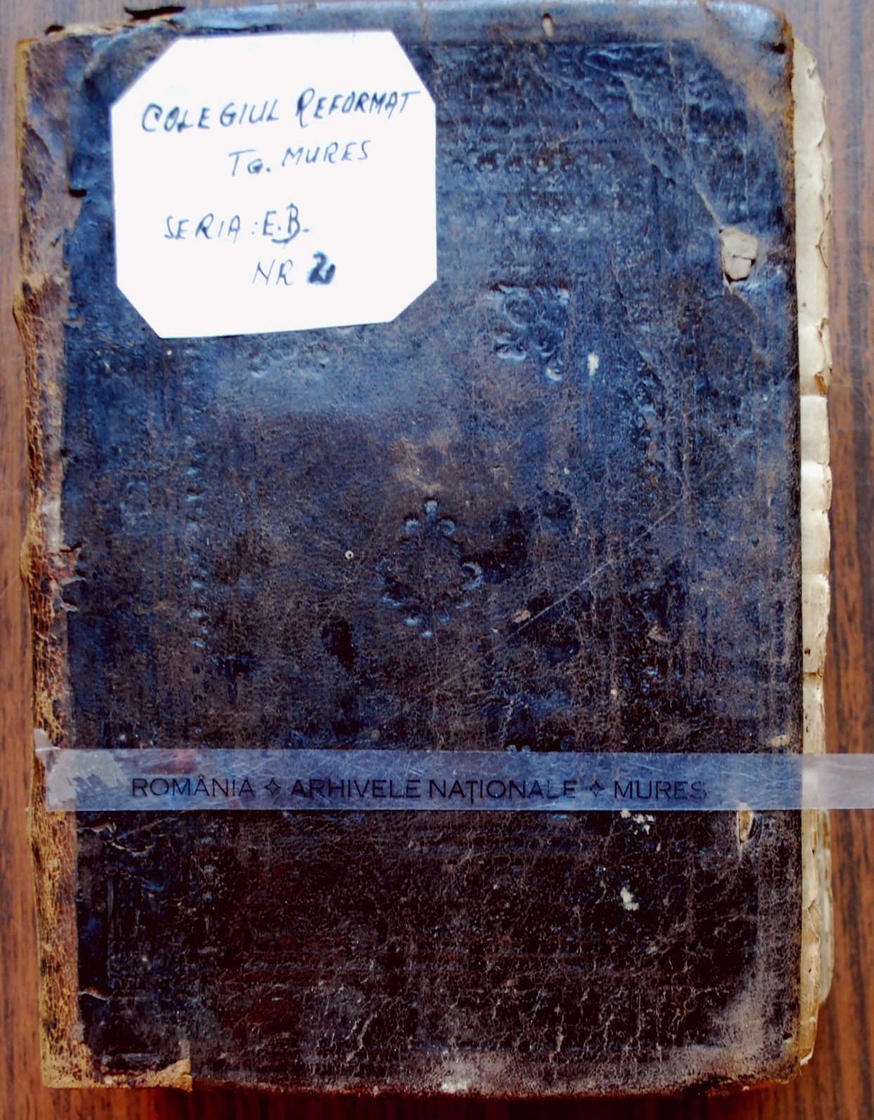

Slide 3
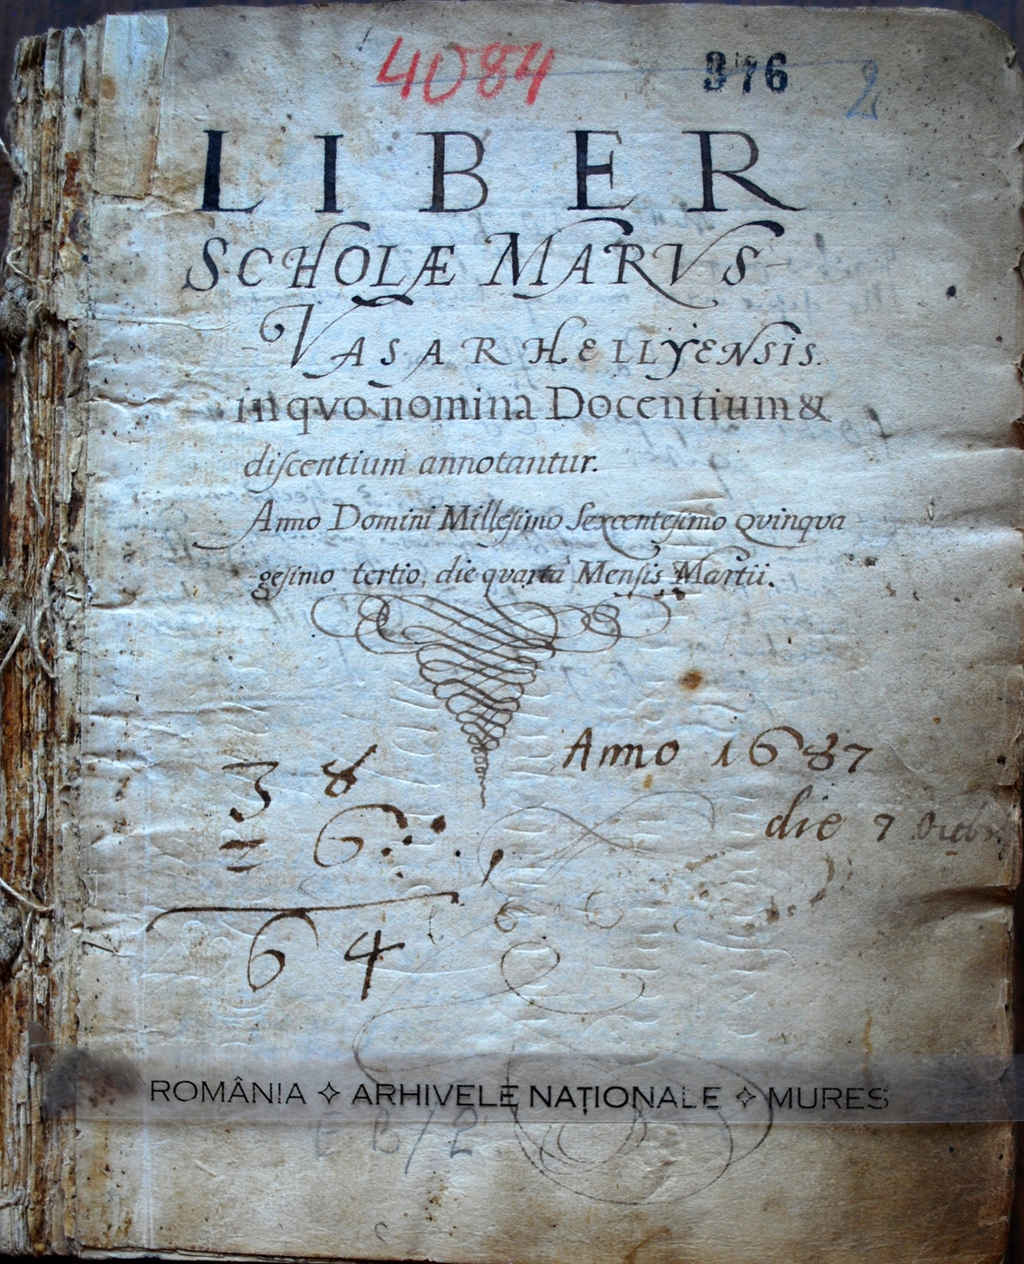

Slide 4
1689
7. Versio 4 Libror[um] Georgjcor[um] Virgilij per Johan[n]em Apacius Lib[er] M[anu] S[criptum]
8. Petrj Ramj Arithmetica et Grammatica
9. Interpraetatio Hungarica Officior[um] Ciceronis ejusd[em] Clarissimi Johannis Apaczaj de eadem voluminem.
1707
In serie quarta nova series seu ordo exterior
11. Libri secundi Georgicorum versio hungarica et Arithmetica et alia scripta ut est Aurei libri Marci Tulii Ciceronis de officijs hungarica versio a Johanne Apaczai Albae Juliae a Matthia Fogarasi exscripta 1655

Slide 5
Classis | Gyulafehérvár 1629 , German professors – Noémi Viskolcz | Gyulafehérvár, 1653 , Apácai – Örs Dóczy | Kolozsvár, 1656 , Apácai – Örs Dóczy | Marosvásárhely, 1662, Fogarasi – Annamária Kimpián
Primae | Writing and reading in Latin | Reading and writing in native language Writing and reading the letters and word forms of Latin, Greek, Hebrew and Arabic, without grammar | Rudimenta – only in Latin | Rudimenta – vernacular language too Latin-Hungarian translations
Secundae | Latin grammar | Same as above | Ethimology | Ethimology Hungarian-Latin translations
Tertiae | Hungarian-Latin translations Elements of Latin poetry– Terentius Greek language | Hungarian Encyclopaedia – brief summary of sciences in Hungarian Grammar of the four foreign languages Translations | Syntaxis | Syntaxis and poetics Style exercises in Hungarian
Quartae | Latin translations, text adaptations, independent poems – Cicero Officia Greek language Fundamental of Rhetoric and Logic | Same as above | Rhetoric
Quintae | Using the rules of logic and rhetoric in practice Greek language |  | Poetics
Academia/ Collegium | Theology Bölcsészet | 1. Rhetoric, Poetics and History 2.Logic 3.Mahtematics, Astronomy, Music 4.Physics, Medicine 5.Theology, Ethics, Family Ethics, Church Organisation, Politics and Law | Theology Logic | Classis suprema: Rhetoric Logic Theology

Slide 6
Books used for teaching by Mátyás Fogarasi (based on the curriculum)
Rudimenta – we have no information
Etymologia – Terentius Christianus
Syntaxis and Poetica – Vergilius Evangelizans
Rhetorica, logica, theologia –
  Greek language – New Testament
  Hebrew language – Psalms of David
  Buchanan Psalmorum [Davidis]
  Cicero: De oficiis
  Vergilius: De venere; De viro bono
  Vergilius Evangelizans
  Terentius Christianus
  Amesius: Technometria
  Amesius: Cathechesis [Christianae catecheseos sciagraphia.]

Slide 7
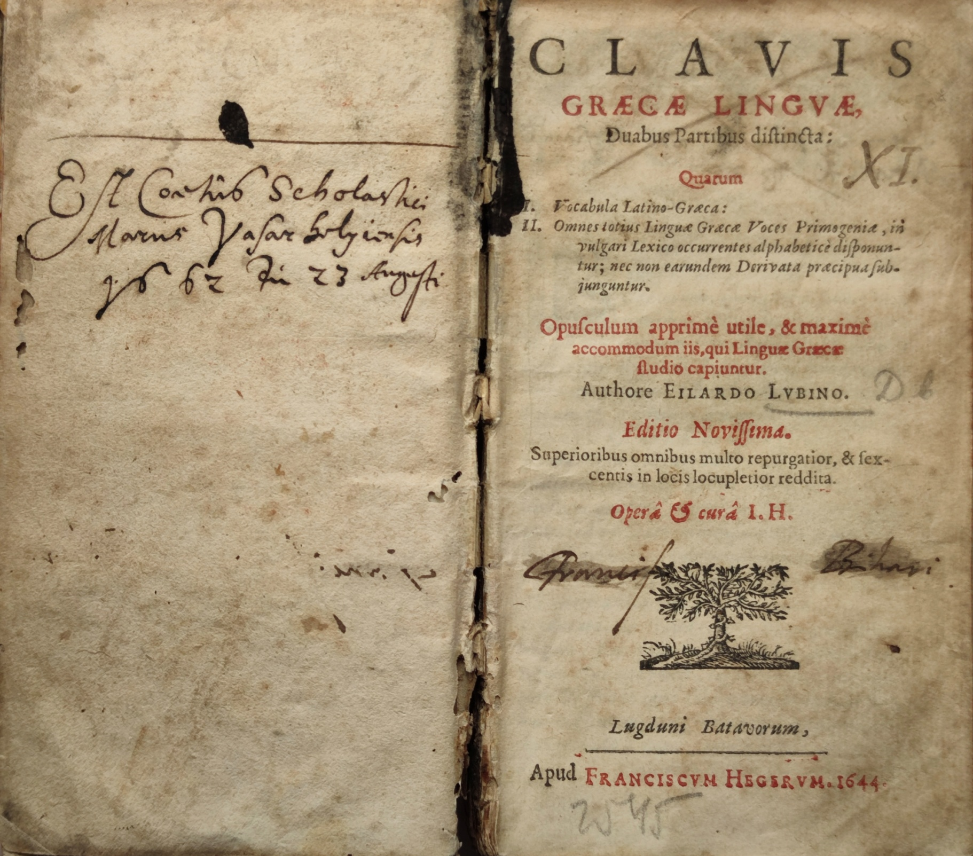

Slide 8
Students of Mátyás Fogarasi
Ferenc Pápai Páriz
Péter Daróczi, rector in Gyulakuta
Miklós Zabolai, rector in Búza
Casparus Regerus, cantor in Szászrégen
András Etédi, died a year later (1665, during the rectorship of Pál Hunyadi)
Péter Selyki – Kolozsvár, Marburg, Utrecht, court priest of Mihály Teleki, later pastor in Újtorda
Balázs Gidófalvi – was twice rector in Marosvásárhely
  Copies Mátyás Fogarasi’s inaugural speech into the Csulai-register
  collaborator (ethimology class), then contrascriba
  Frequent participant in theological school disputations as both opponent and respondent
  1667. april 27 Enyed – contrascriba
  1673-1677 Marosvásárhely, rector
    1674 – copies and expands on the school laws (collaborator, explorator, cook)
  1679. April 1 – Leiden
  1681. April 24 – september 9, Marosvásárhely, rector
  1681. September Gyulafehérvár, priest

Slide 10
The teachers have the duty to get to know their students, to set them on the path of knowledge, to educate them to be human. NOT by intimidation, threats, beatings, but by encouraging them kindly, by drawing attention, by friendship and by interesting lectures. In addition, they should also provide moral education, so that they can look at them as role models, follow them in living for their profession, so that they can say about them: “He taught professionally, his words were followed by his actions”

Slide 11

Thank you for your attention!

