Slide 1
Humanism and Reformation at the University of Wittenberg (1524-1574)
Declamations and the utility of academic studies for church and society
Paper conference “Transfer of Knowledge and Scholarship in the academic world”
Dr. J. van de Kamp
17 september, 2025

Slide 2
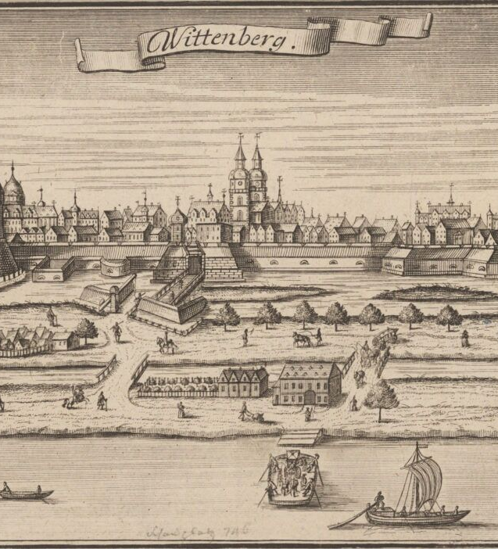
1. Introduction
Humanism – Reformation: more transformation than rupture
  Continuity: use of linguistic forms/media to make content useful to church and society
  Changes: target group degrees, purpose of education and view of man
Transformation – how?
  University of Wittenberg (Leucorea)
  Teaching form: declamationes

Slide 3
Structure
2. Declamations
3. State of research
4. Theoretical framework
6. Methodology
5. Research questions
7. Conclusion

Slide 4
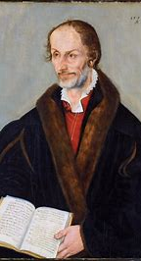
2. Declamations
Relation to Humanism - educational forms and media
  Strategies author et al.
Introduction in Wittenberg: 1524, Melanchthon
Training in eloquence
Range of topics
Role of Melanchthon
1524-1574 (coincides with fall of Philippists)

Slide 5
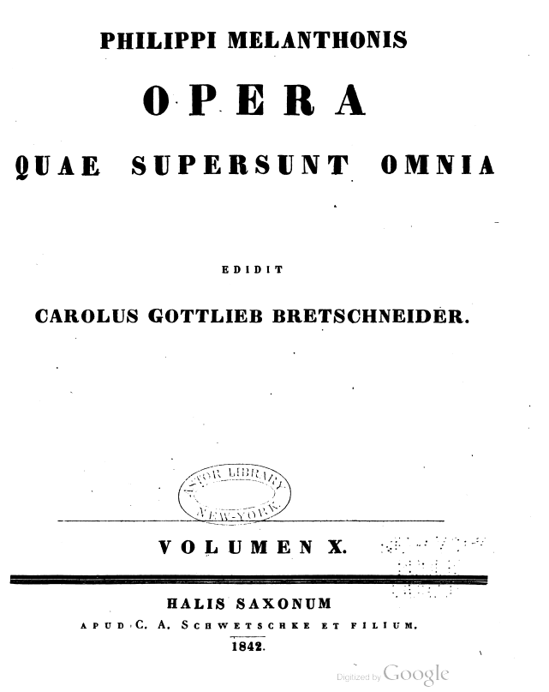
3. State of research concerning the Wittenberg declamations (1)
Editions: Corpus Reformatorum (CR) vols. 10-12 (1842-1844); Melanchthon-Studienausgabe (MSA) vol. 3, 1961
Bibliography: a.o., Koehn 1984; Claus 2014

Slide 6
3. State of research concerning the Wittenberg declamations (2)
Studies: analysis of contents:
  Vitae of (historical) persons: Scheible 1993
  Medicine: Hofheinz 2001
  Law: Kisch 1967; Deflers 2005
  authorship: most recently Gößner 2022: “Melanchthons Geist in Örtels Worten“: Veit Örtel ‚1st author‘, Melanchthon ‚2nd author‘
However, no comprehensive study yet
new angle: usefulness of contents for church and society

Slide 7
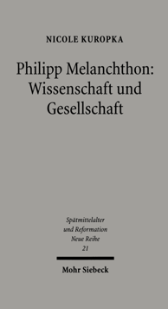
4. Theoretical framework (1)
usus or utilitas of scholarly research and education
  in Humanism and Reformation in general
  At Wittenberg and with Melanchthon
    Wittenberg: “utilitarian[s]” view of education (M. Wriedt)
    Melanchthon: “Wissenschaft und Gesellschaft” (N. Kuropka)
    “funktionale Christologie” (C.H. Ratschow)
    Declamations:
      materiae rerum utilium (J. Camerarius)
      usus and utilitas

Slide 8
4. Theoretical framework (2)
2. cultural transfer (Late Middle Ages/Humanism – Reformation)
which contents
which sources
to what extent and how made beneficial to church and society
how disseminated

Slide 9
5. Research questions
To what extent and how were declamations at high schools in the sixteenth century, especially in Wittenberg, making the study of all kinds of subjects useful to church and society?
From what sources?
To what extent and how made useful to church and society?
In what form presented?
How the contents further disseminated?
How did the declamations at Wittenberg compare with those at other universities?

Slide 10
6. Methodology (1)
  Bibliographical research:
    bibliographical list of the declamations and chart the topics
    identify possible sources of the Wittenberg declamations (RQ1) + publications that may have been influenced by the Wittenberg speeches (RQ4-5).
  Analysis contents declamations (RQ2)
  Literature study
    Comparison of Wittenberg declamations with those at other colleges (RQ5)
  Literary analysis:
    form and structure of the speeches, stylistic devices (RQ3)
    Parallel to research: edition of declamations, a.o., in Melanchthon, Opera Omnia (ed. Frank/Leppin/Selderhuis)

Slide 11
6. Methodology (2)
  Literature study
    Comparison of Wittenberg declamations with those at other colleges (RQ5)
  Literary analysis:
    form and structure of the speeches, stylistic devices (RQ3)
    Parallel to research: edition of declamations, a.o., in Melanchthon, Opera Omnia (ed. Frank/Leppin/Selderhuis)

Slide 12
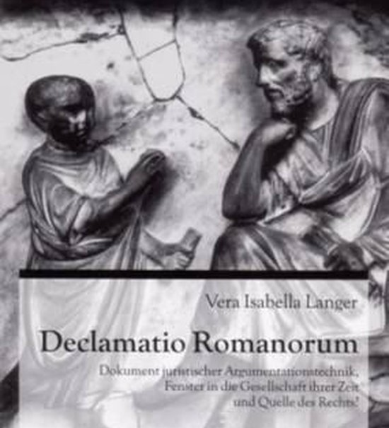
7. Conclusion - relevance of the research
contribution to the study of academic education from the Reformation side in the sixteenth century:
  relationship to Humanism and Reformation, particularly in Wittenberg
  Purpose of university education
  Significance of Wittenberg university

