Slide 1

The Farm Tale
Mgr. Zuzana Lukáčová, PhD. and Mgr. Jakub Souček, PhD.

Slide 2
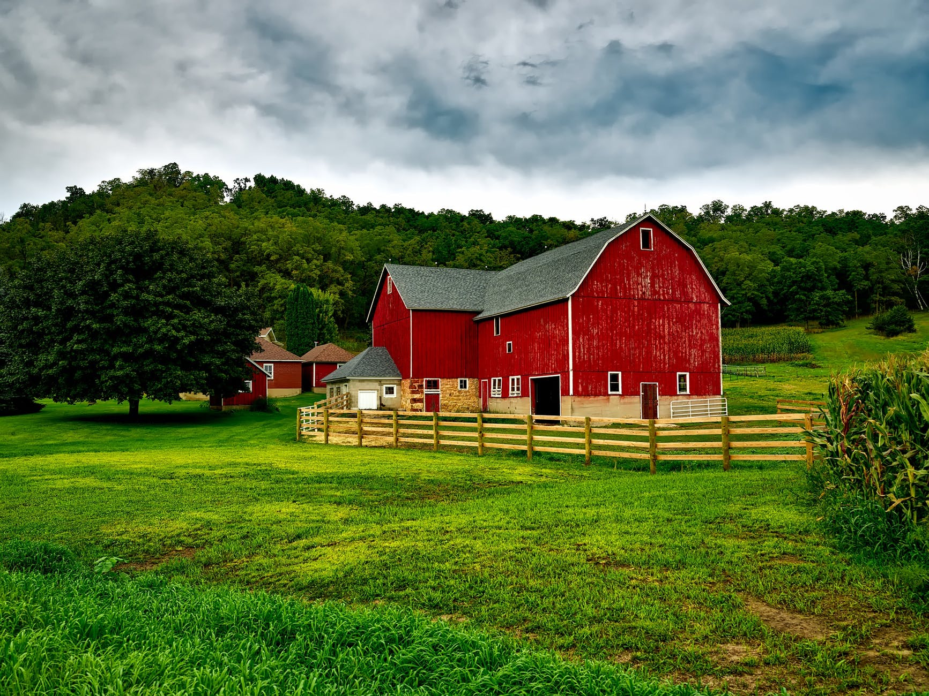
Once upon a time, there was a boy named Teddy. Teddy lived on a farm with his whole family.

Slide 3
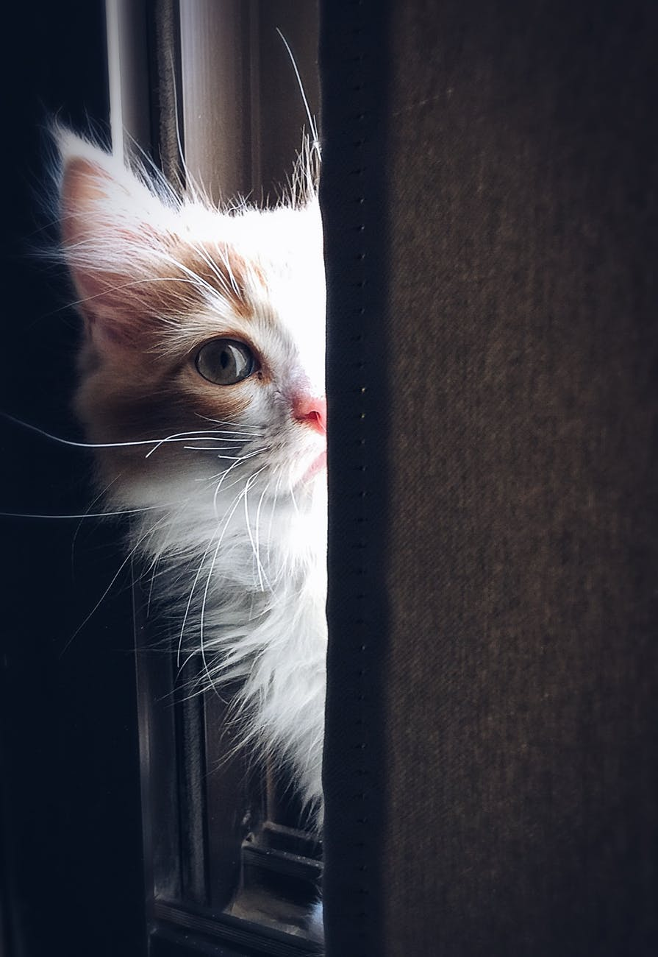
The farmhouse was amazing! It was the most beautiful house you can imagine. Teddy could play hide-and-seek all day long and yet he was not spotted by anybody. Even his little sister Amy had troubles finding him!
Help Amy! Where is Teddy hiding?

Slide 4

While he was hiding, Teddy liked to pretend he was one of the farm animals.
Crawling under the sofa in grandparents’ living room, he clucked like a lost chicken.
Crouching in the shower, he grunted like a piggy who just took a mud bath.
Standing behind the curtains in his bedroom, he mooed like a cow.
Show Teddy what other animal sounds he can make!

Slide 5
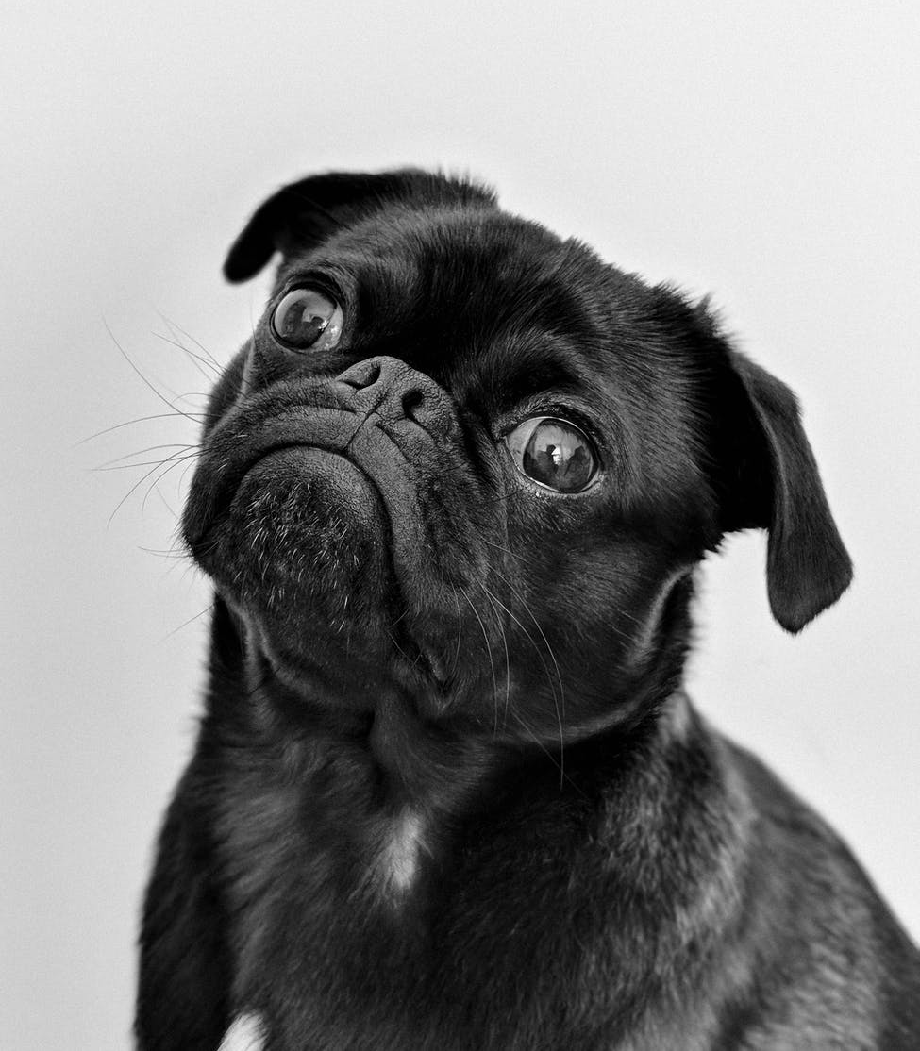
Such a symphony of sounds and Amy still could not find him. Perhaps she was not trying enough. Maybe she was working on her secret mission. It is entirely possible that she was the one under cover.
What could Amy’s secret be?

Slide 6
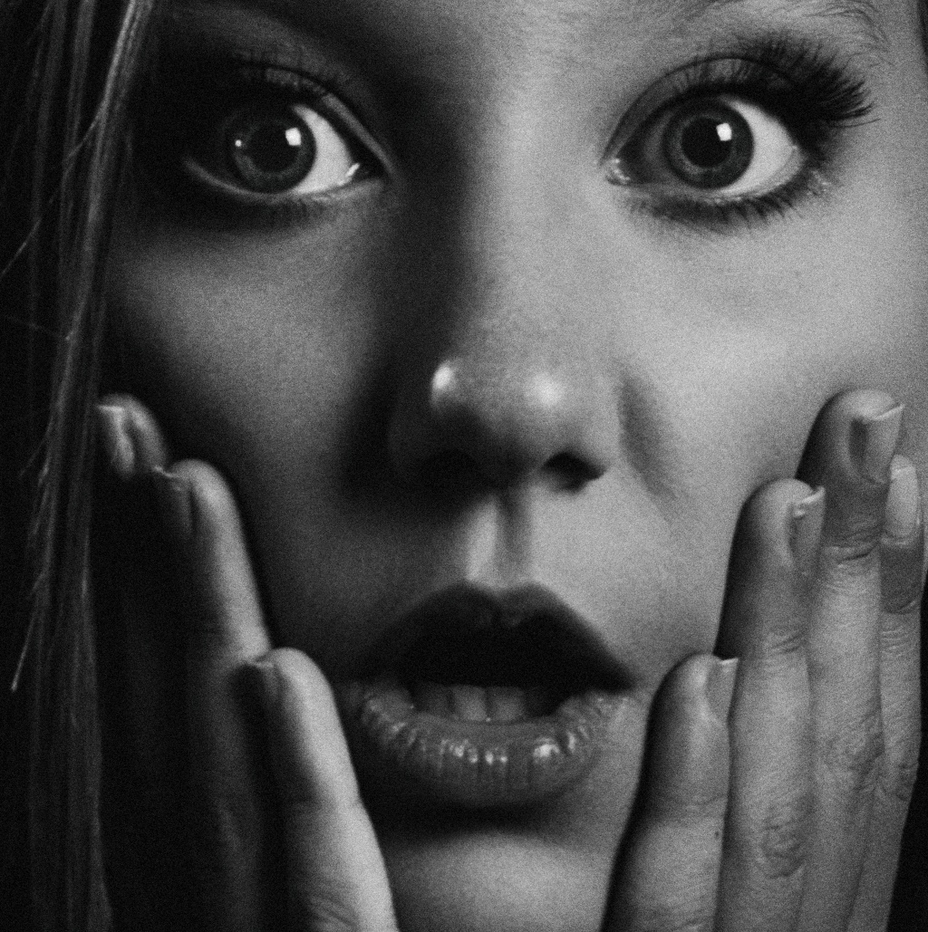
One day, when Teddy was hiding in the cellar, Amy’s secret was discovered by her mother. It was lunchtime and Amy’s mother was finishing the meal when suddenly, she heard a crunching sound from the closet.
“What is that?” mother asked.
What did Amy’s mother hear?

Slide 7

Amy’s mother followed that strange sound to the bedroom. When she opened the closet and looked inside, there it was! Something was hidden behind the clothes!
Draw a picture of that “monster” in the closet.

Slide 8
It was not a monster, but her daughter!
“What are you doing here, Amy?” said mother.
“I… I am… hiding from Teddy,” Amy replied and blushed.
“Nonsense! You were eating all the sweets again, weren’t you?”
What are Amy’s favourite sweets?

Slide 9
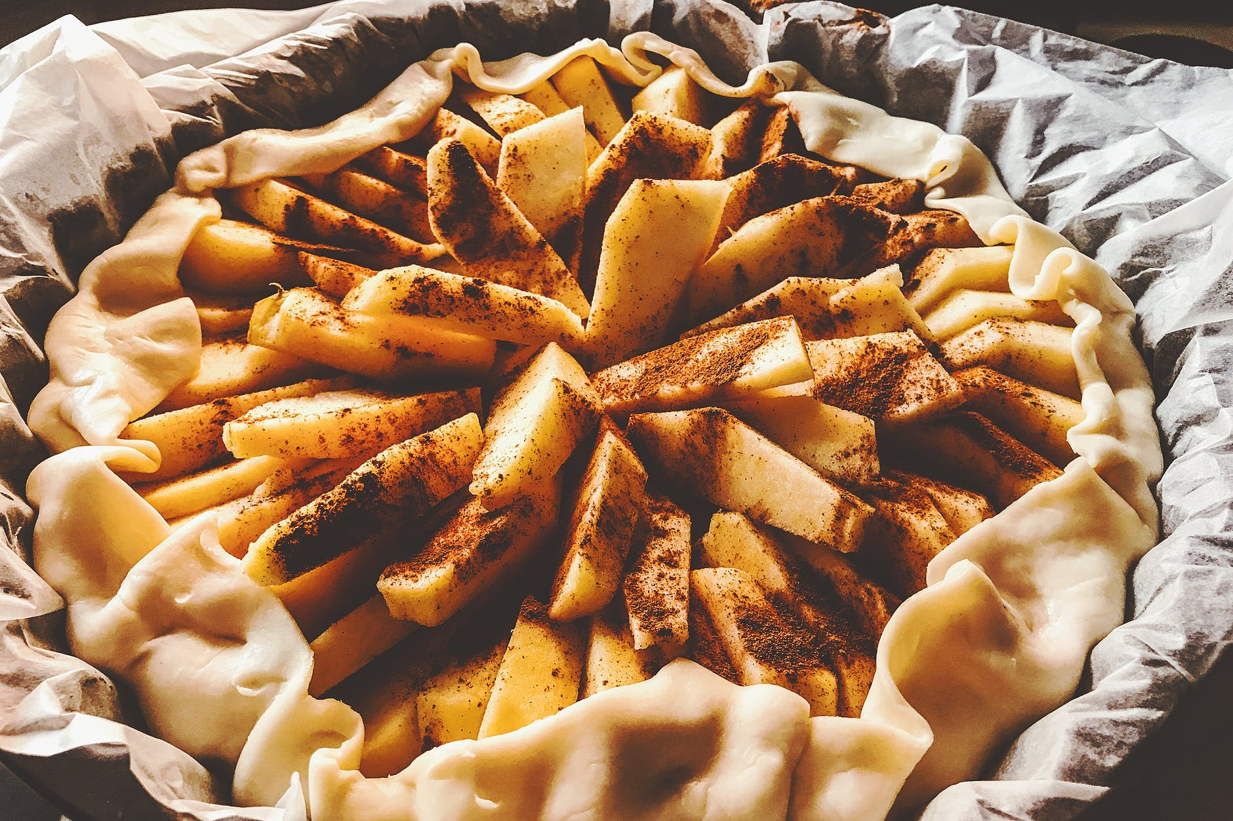
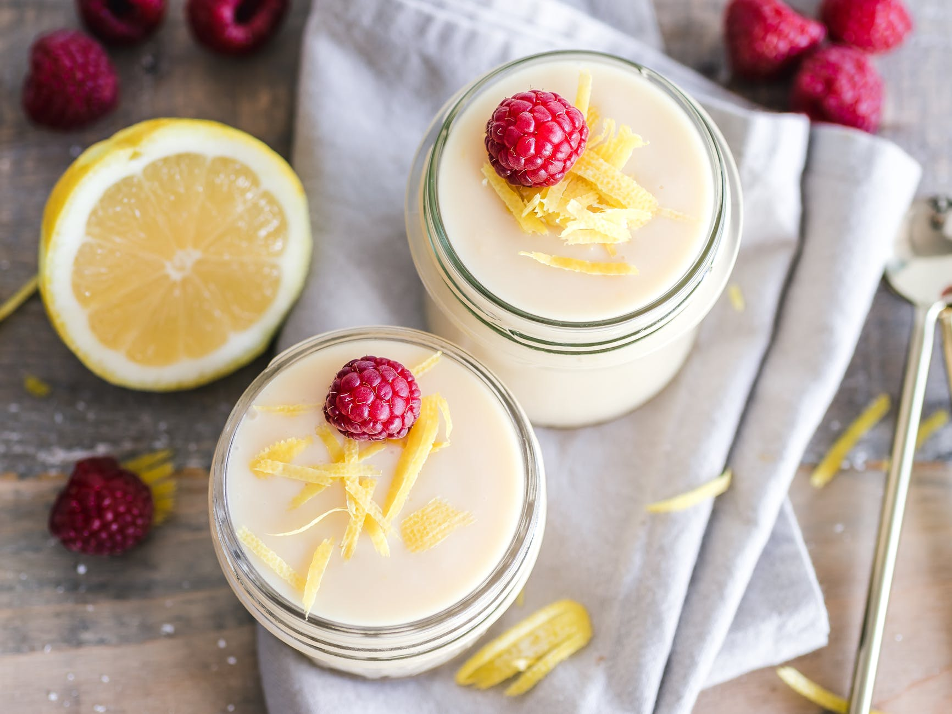

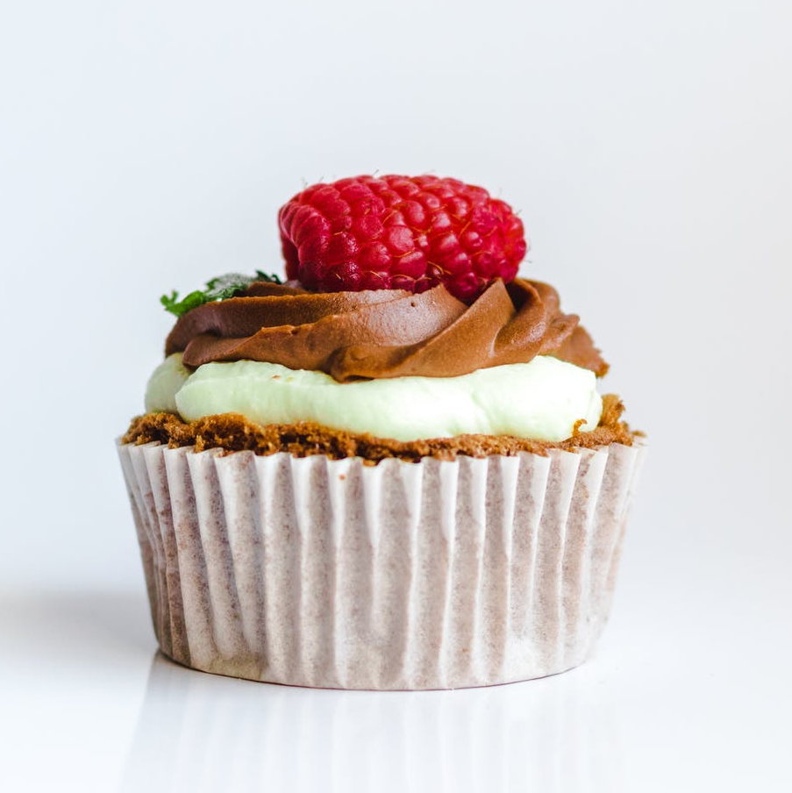
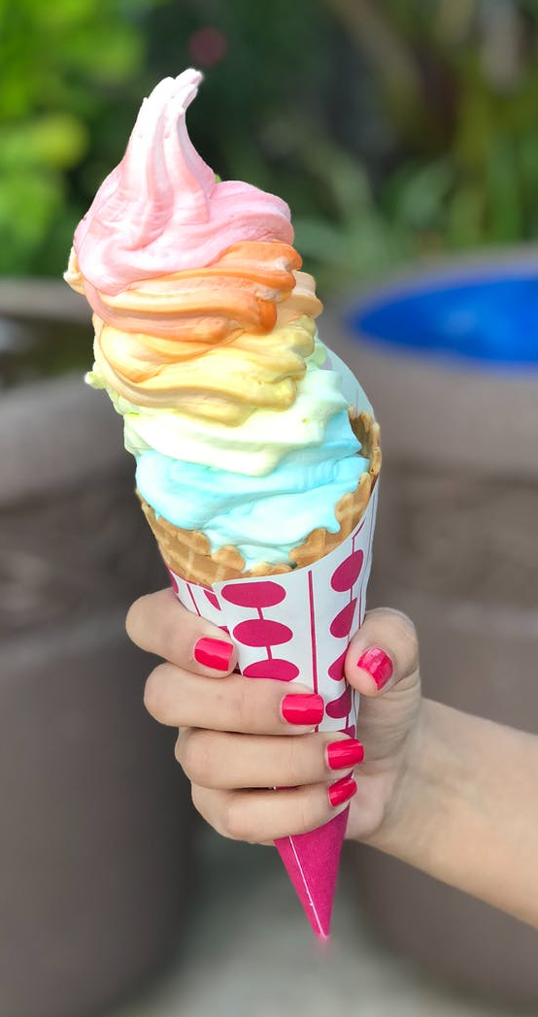
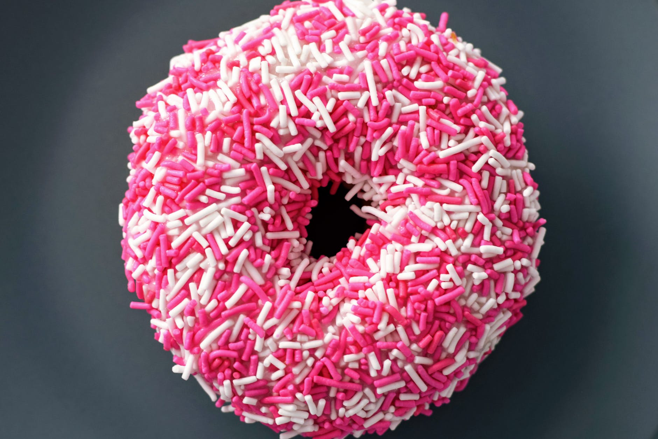
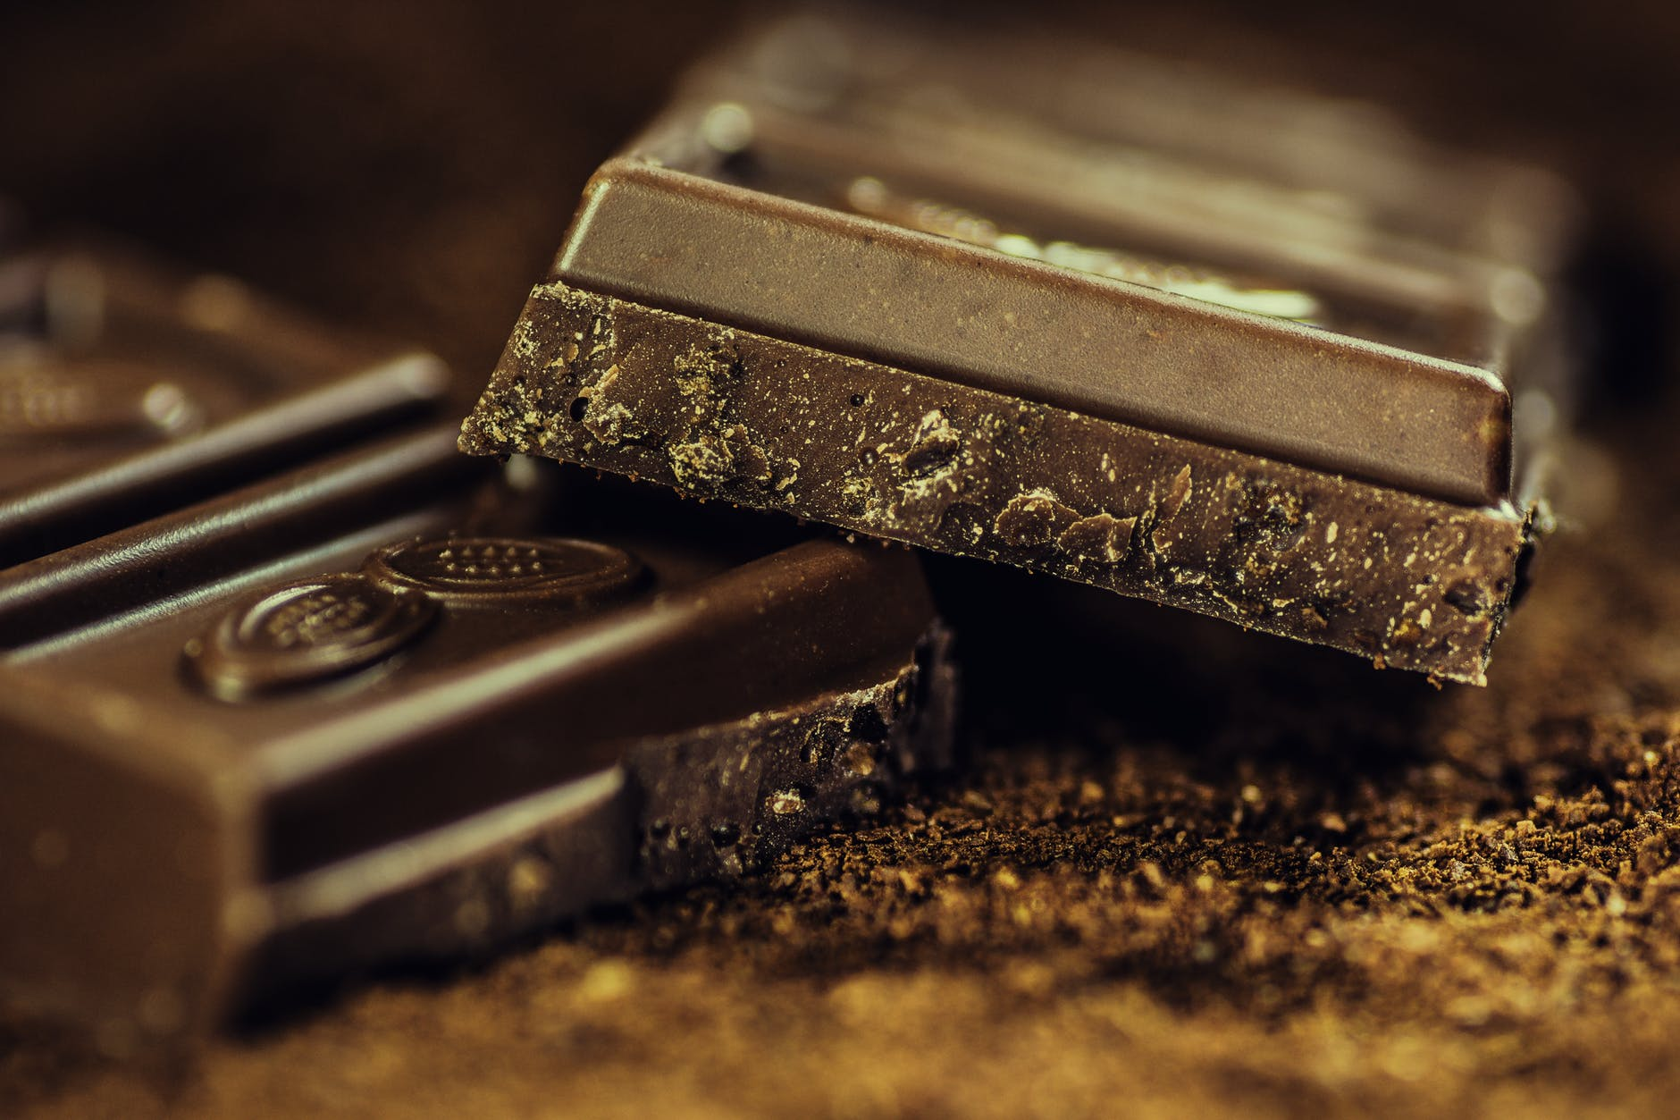
Match the pictures of sweets with their names.
1. Apple pie; 2. Donut; 3. Cupcake; 4. Ice cream; 5. Chocolate; 6. Lollipop; 7. Pudding

Slide 10
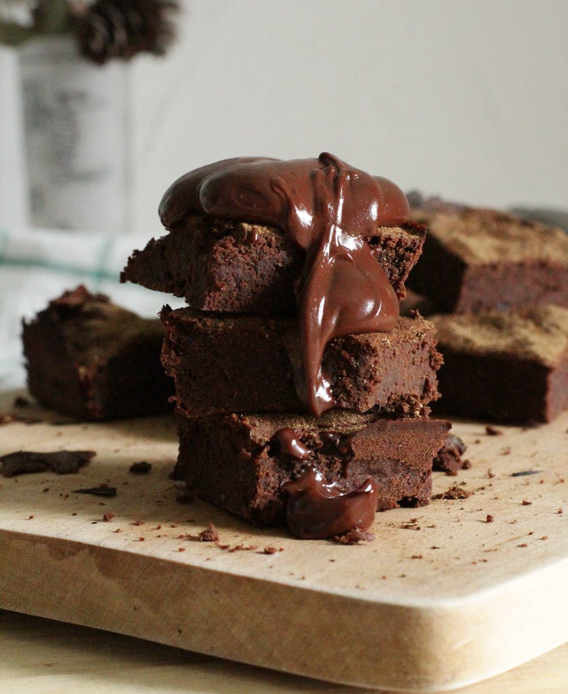
Amy looked at her mother with a guilty expression.
“I didn’t have any sweets,” she said with a mouth full of chocolate.
Amy’s mother burst into laughter: “Go find Teddy and give him some of those brownies, too”.
What would you like to share with your friends?

Slide 11

Help Amy find Teddy once again!

Slide 12
Soon after Teddy and Amy reunited, they got startled by grandpa’s cries: “Loraine, where are you? Are you hiding again? It is not funny anymore.”
Quickly they pursued the sound of grandpa’s voice.
“Loraine, I have a cube of sugar for you. Or would you prefer some hay? Loraine, where did you leave those beautiful horns?”
Who or what might Loraine be? What other animals are living on the farm?

Slide 13
Solve the following animal riddles.
1. I have lovely long hair and a fluffy tail. Come and meet me in the stable.
2. I like to wake up early in the morning, wake up with me too!
3. Be afraid of me! I am on the guard here, so behave appropriately!
4. Catch me if you can. Maybe if you have some carrots with you, I will come to you for a bite.
5. Look how woolly I am. I look like a cloud!

Slide 14
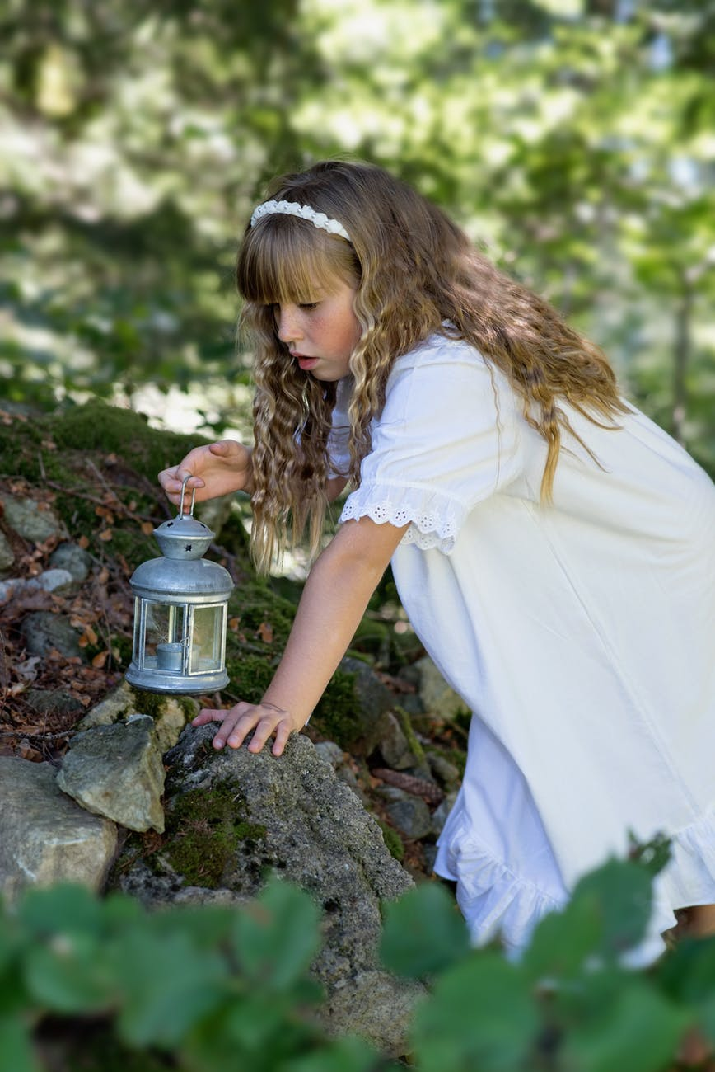
Shortly afterwards, everybody was looking for Loraine. Teddy was running around the dog kennel, Amy was searching through the henhouse and their parents were examining the shed.
Even grandma stopped doing the crossword puzzles and joined the hunt.
What was grandpa doing?

Slide 15
Match the animals with their dwellings.
1. Dog a) Hole
2. Bee b) Stable
3. Bird c) Barn
4. Horse d) Nest
5. Cow e) Hive
6. Spider f) Kennel
7. Mouse g) Coop
8. Rabbit h) Cage

Slide 16
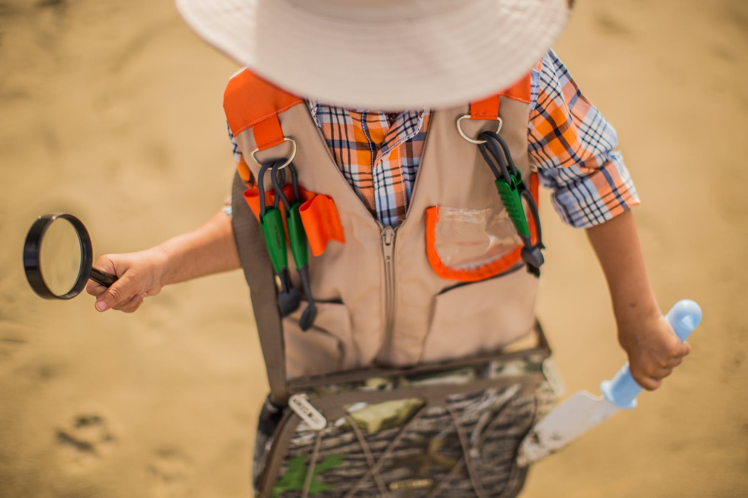
Finally, Loraine was found!
She was not hiding at all. She was in her pen the whole time. And soon after that, grandpa’s glasses were found as well.
The work of our detectives was complete.

Slide 17

Everybody rejoiced and they decided to sing a song together. Join them!

Slide 18

I think we had lots of fun!
See you soon, my friend!

Slide 19
Sources
http://www.orangefreesounds.com/
https://www.pexels.com/
http://www.mazegenerator.net/
https://www.youtube.com/watch?v=_6HzoUcx3eo

Slide 20
ANSWER KEY
1. Apple pie
5. Chocolate
2. Donut
6. Lollipop
3. Cupcake
7. Pudding
4. Ice cream

Slide 21
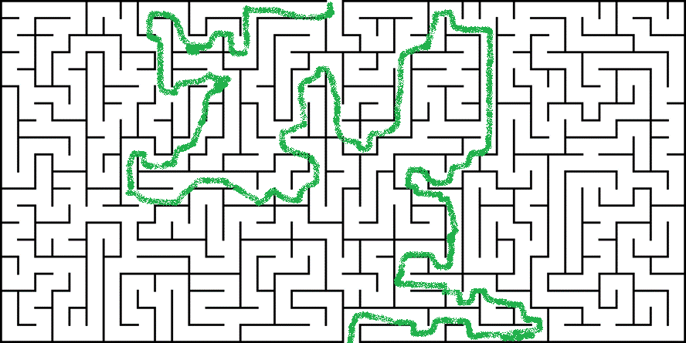
ANSWER KEY

Slide 22
ANSWER KEY
1. I have lovely long hair and a fluffy tail. Come and meet me in the stable.
A HORSE
2. I like to wake up early in the morning, wake up with me too!
A COCK
3. Be afraid of me! I am on the guard here, so behave appropriately!
A DOG
4. Catch me if you can. Maybe if you have some carrots with you, I will come to you for a bite.
A RABBIT
5. Look how woolly I am. I look like a cloud!
A SHEEP

Slide 23
ANSWER KEY
Dog – Kennel
Bee – Hive
Bird – Cage
Horse – Stable
Cow – Barn
Spider – Nest
Mouse – Hole
Rabbit – Coop

