Slide 1
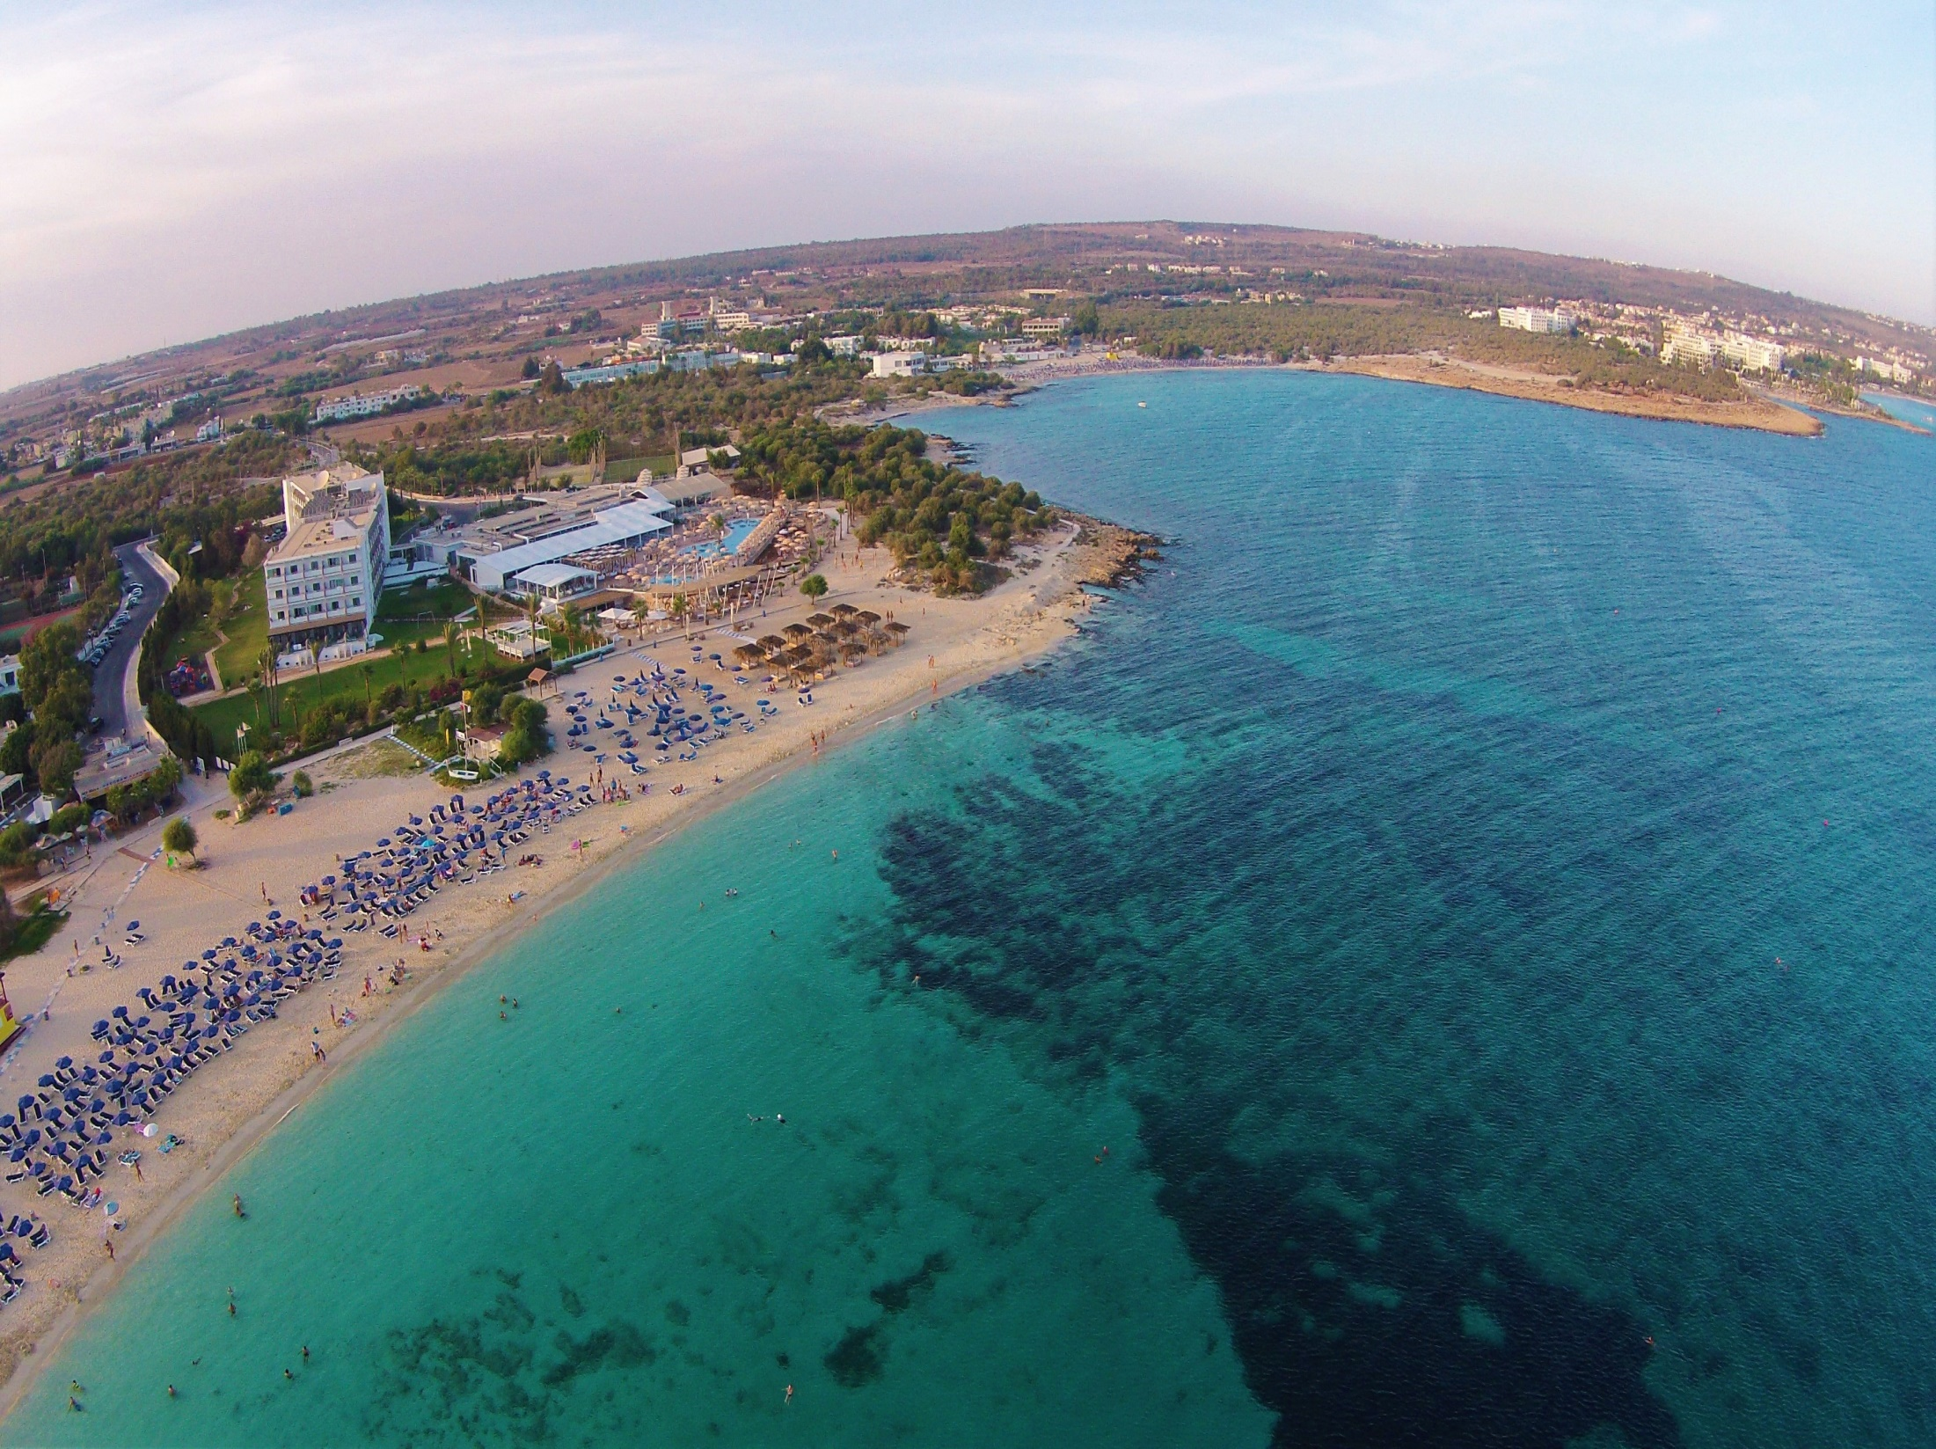


Slide 2
Ayia Napa
Cyprus
Marinos Hadjisoteriou
Assistant Manager

Slide 3
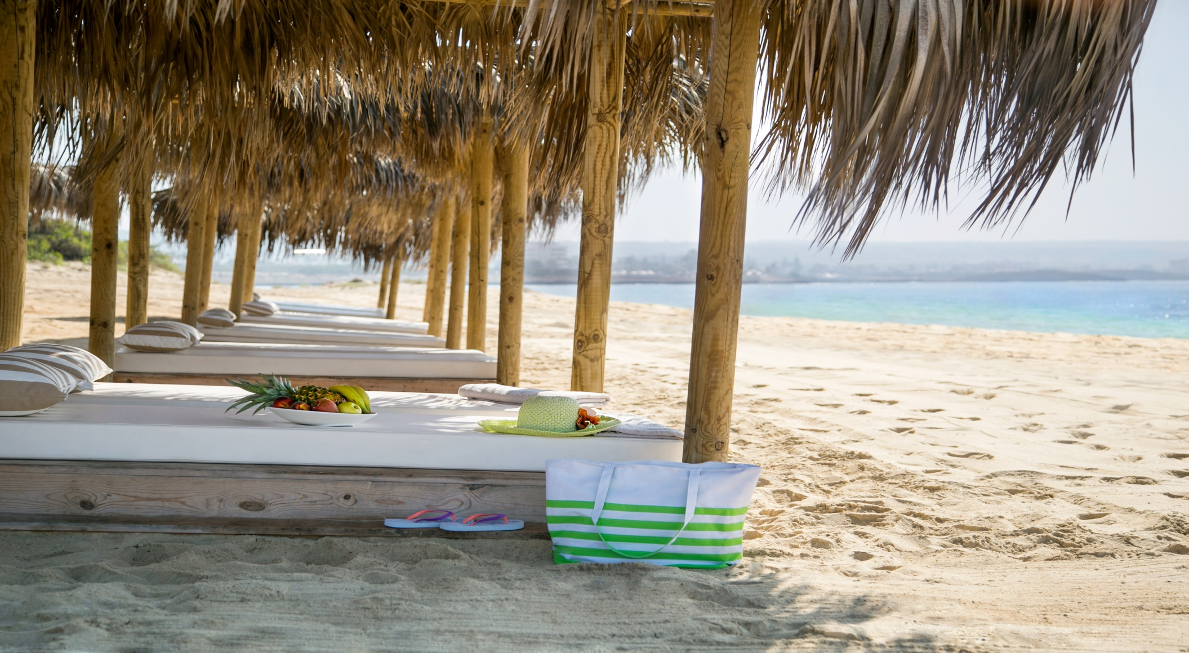
Who we are?
Asterias Beach Hotel is a Four Stars Plus family owned and run Beach Hotel since 1983 located in Ayia Napa, Cyprus. Our guests come mostly from Central European countries like Germany, Austria, Switzerland, UK, Hungary, Russia and other countries.
Our Hotel has 288 Rooms including Junior suites, Superior rooms , Sea view, Family rooms and Garden view rooms. During the last 5 years our Hotel is undergoing intensive renovations that has changed the face of the Hotel and the costumer experience.

Slide 4
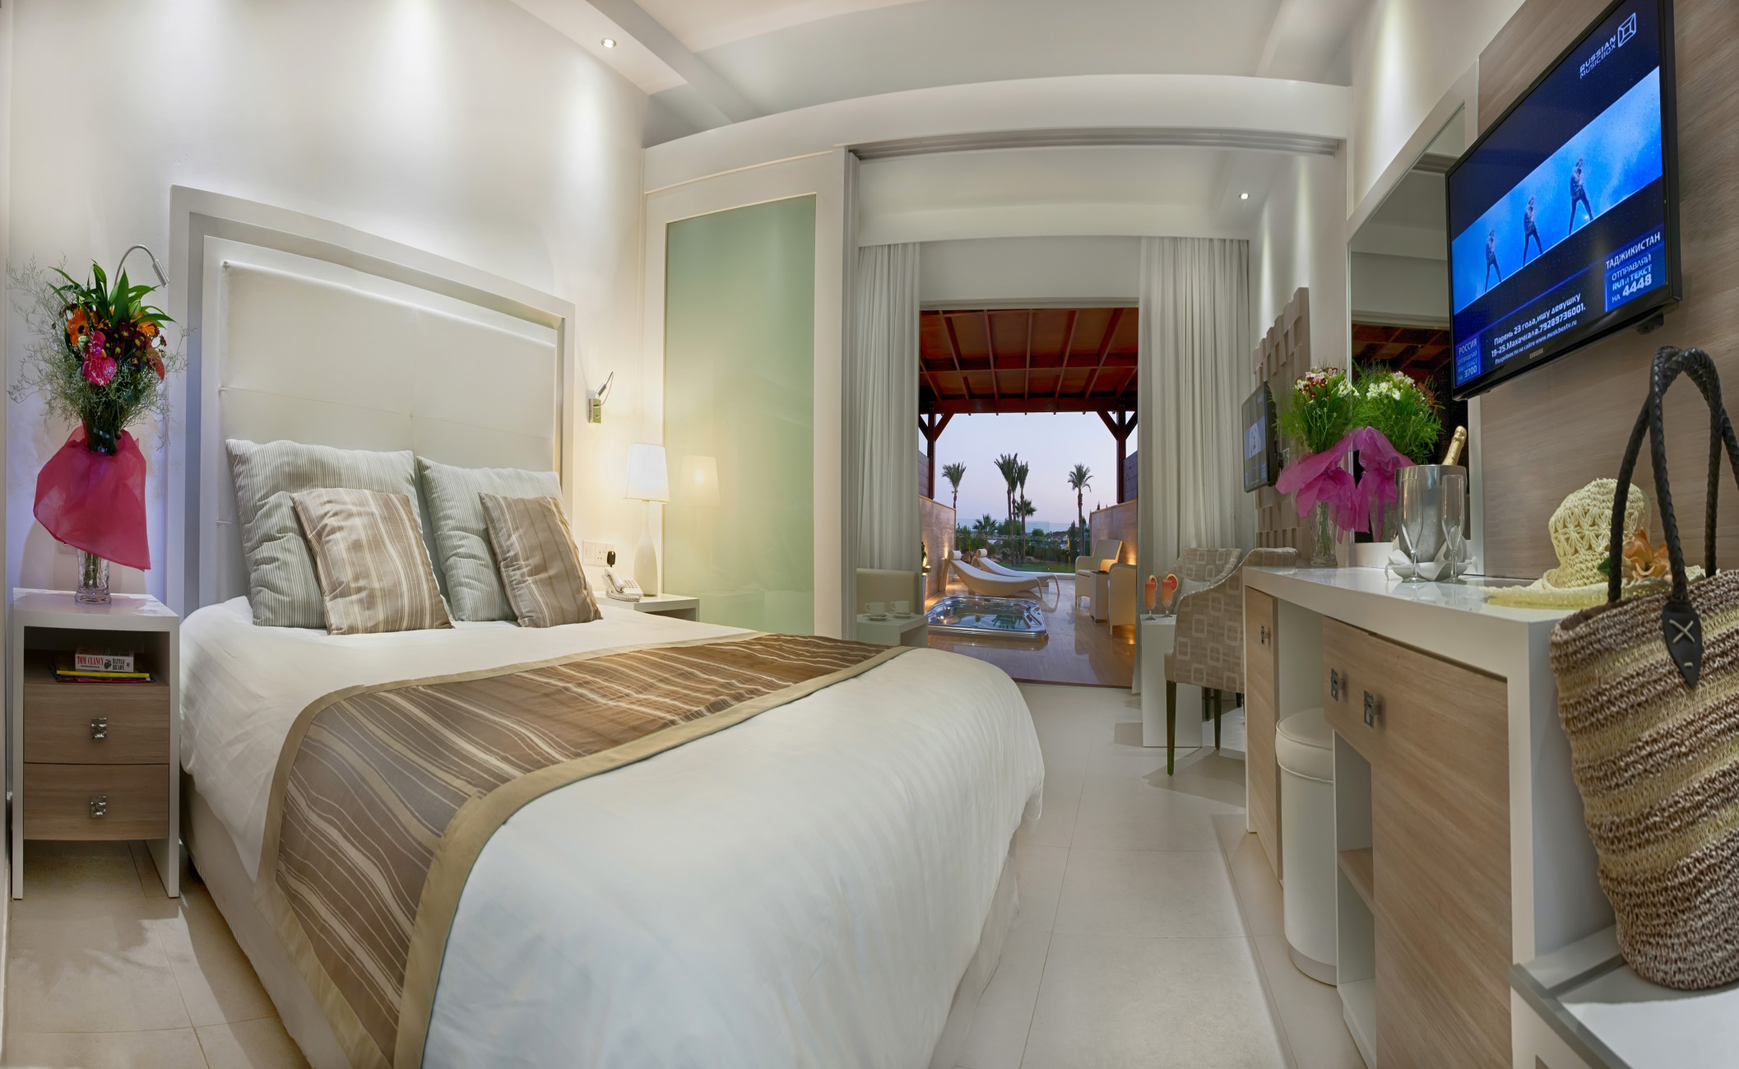
Junior Suite

Slide 5
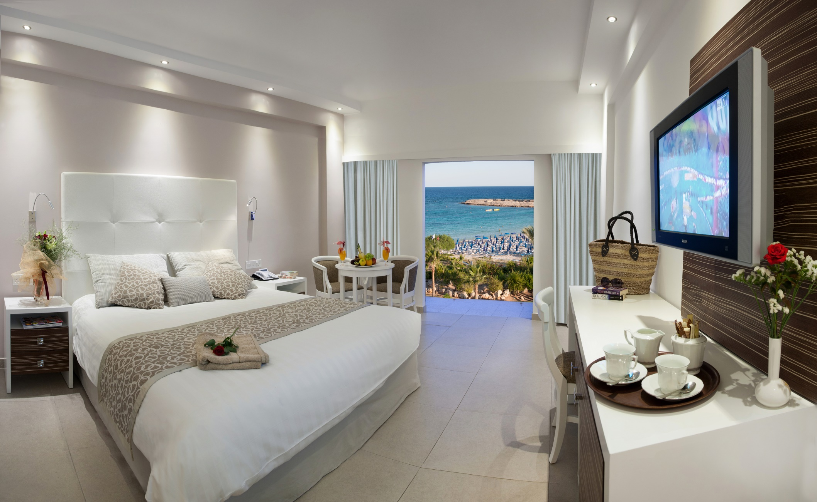
Standard Sea View Room

Slide 6

Where is Asterias Beach?
Ayia Napa, Cyprus
Macronissos Beach:
Blue flag Beach, awarded many times as one of the top beaches in Europe!
Only 3-4Km away from Town Centre
Just under 1KM away from new Marina and the Waterpark!

Slide 7
Facilities and Services
Our Hotel has 4 Restaurants and 2 bars
Two outdoor swimming pools (1 for children)
There is a big spa in the hotel and a fully equipped gym with a 25 meter long indoor swimming
Full Animation program during the day and evening entertainment every night (Dance shows, live music, magic show etc)
All the standard services of a 4 star plus hotel (24h reception, room service etc)

Slide 8
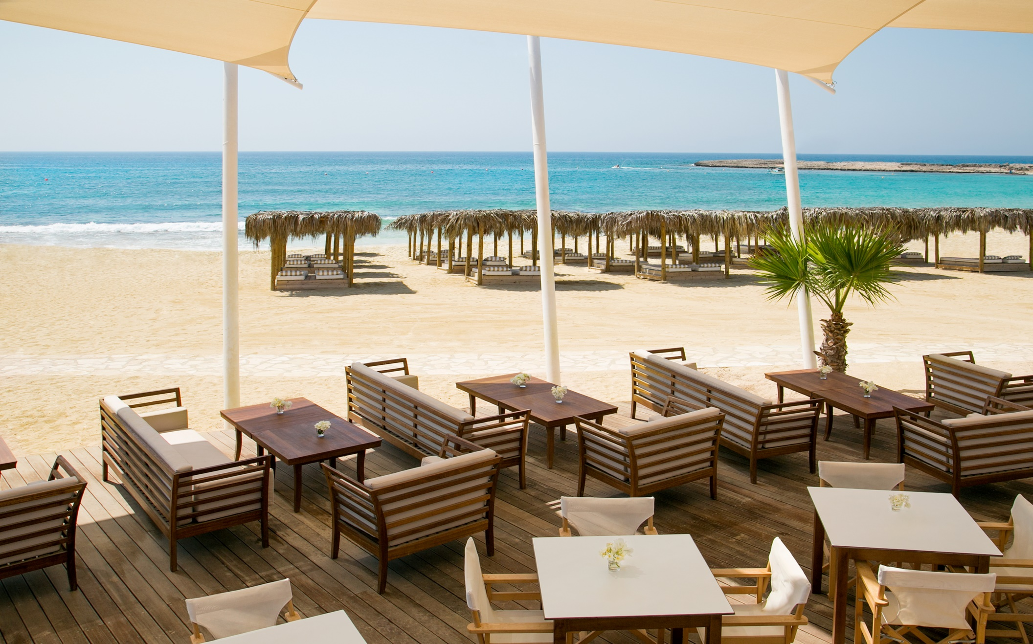
Levels Beach Bar

Slide 9

Levels Beach Bar cont.

Slide 10
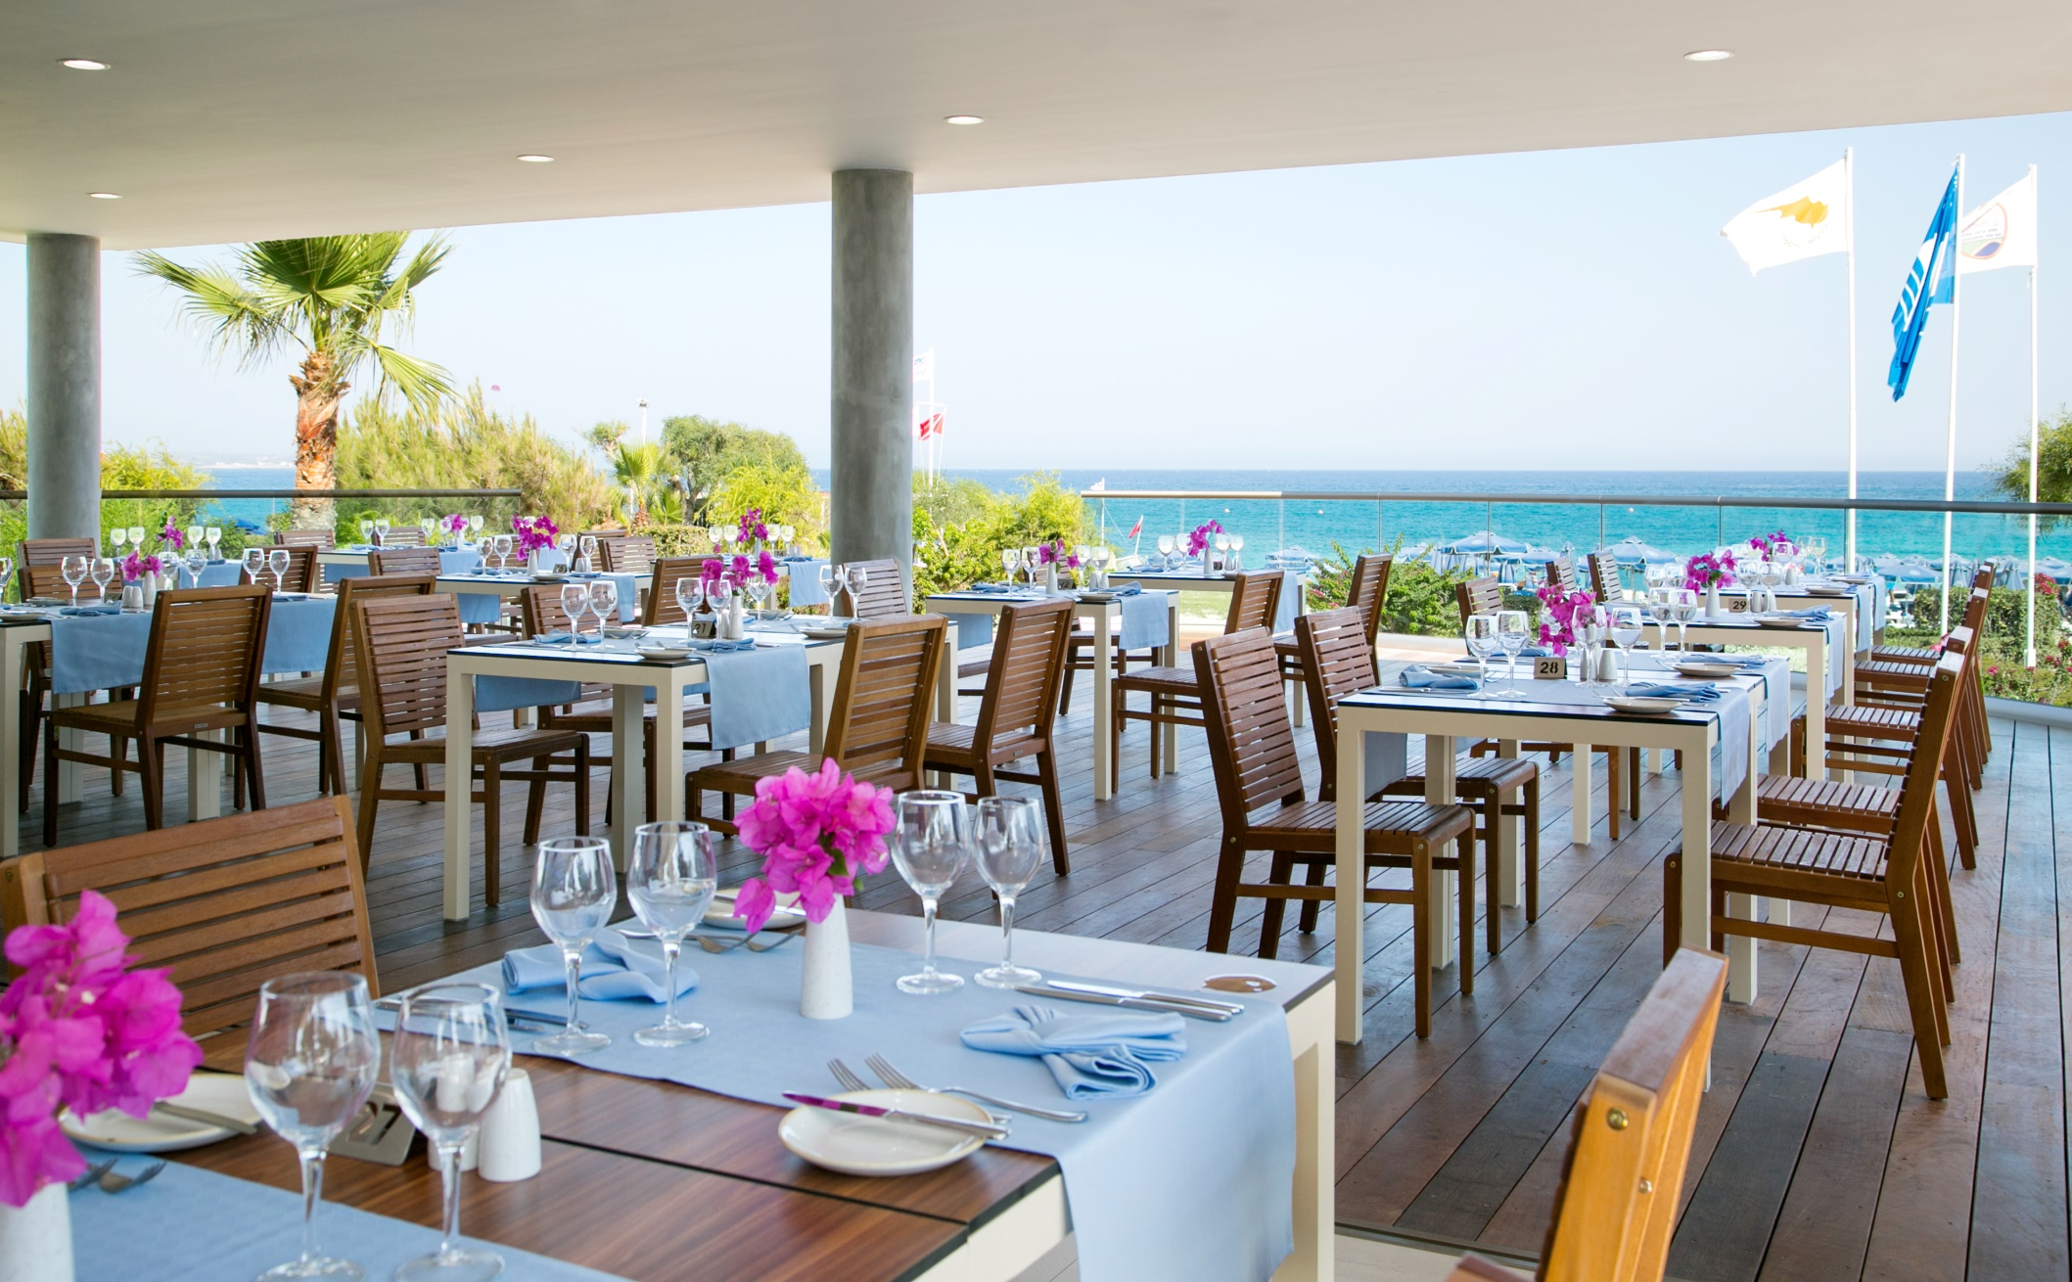
Koralli Seafood Restaurant

Slide 11
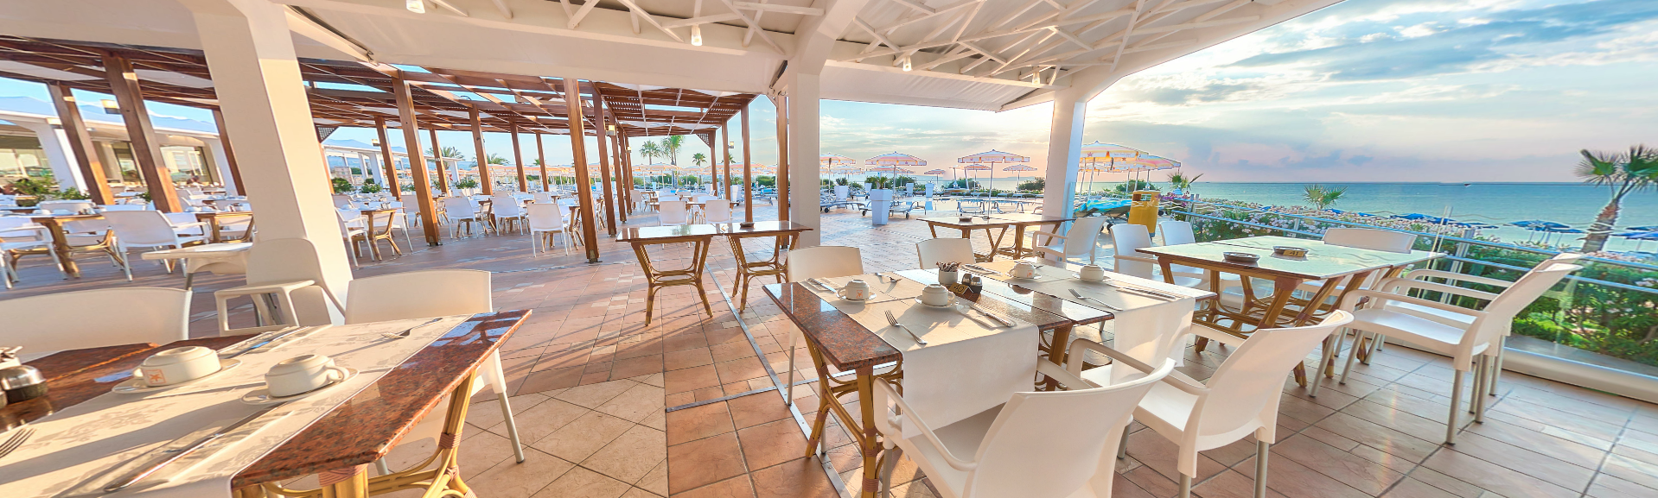
Poolbar/Italian Restaurant

Slide 12
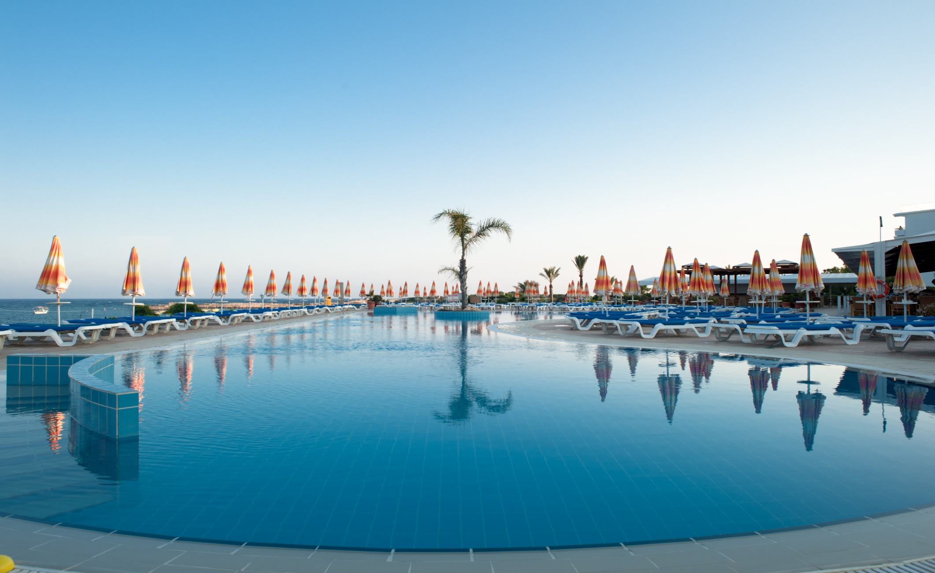
Outdoor Swimming Pool

Slide 13
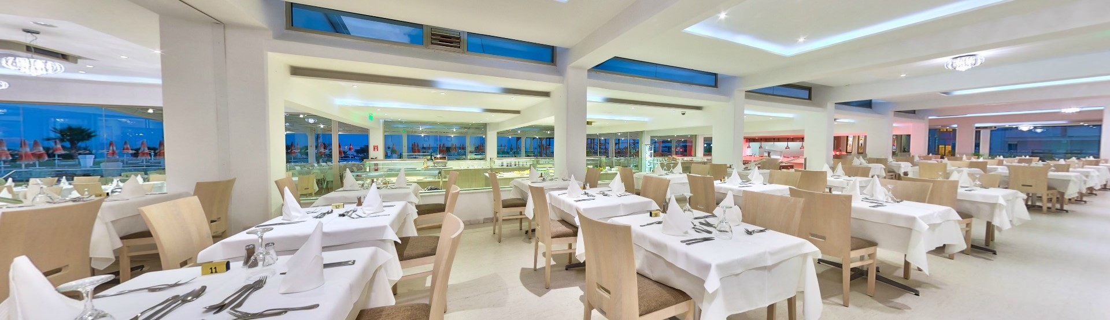
Ammochostos Restaurant

Slide 14
Cocktail Bar

Slide 15
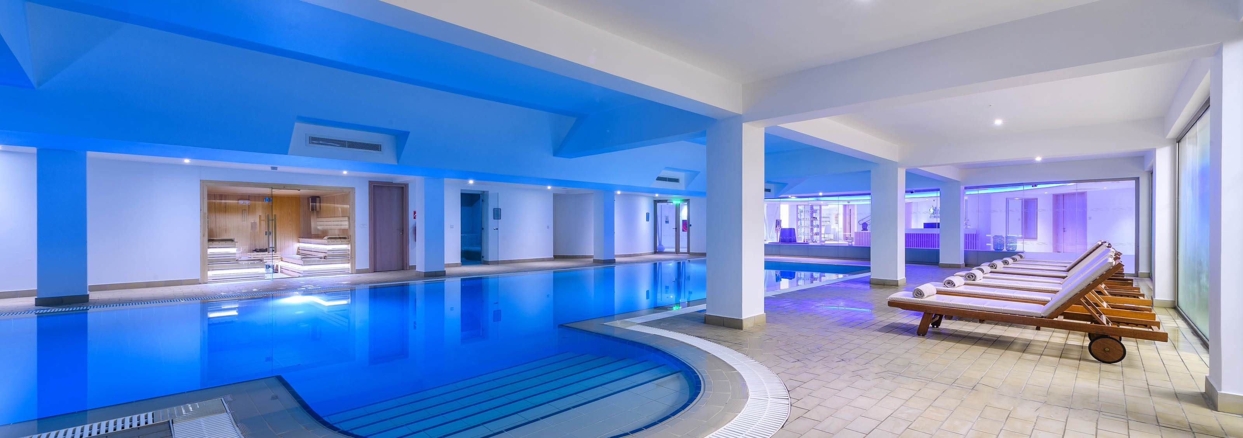
Iris Spa

Slide 16
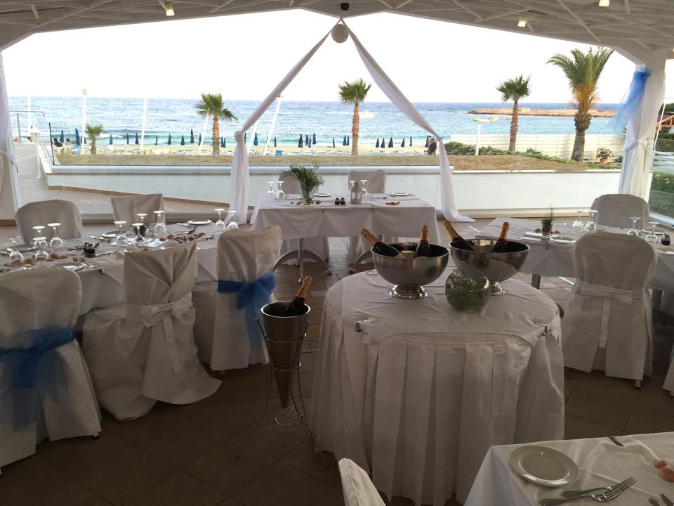
We also do beautiful Weddings

Slide 17
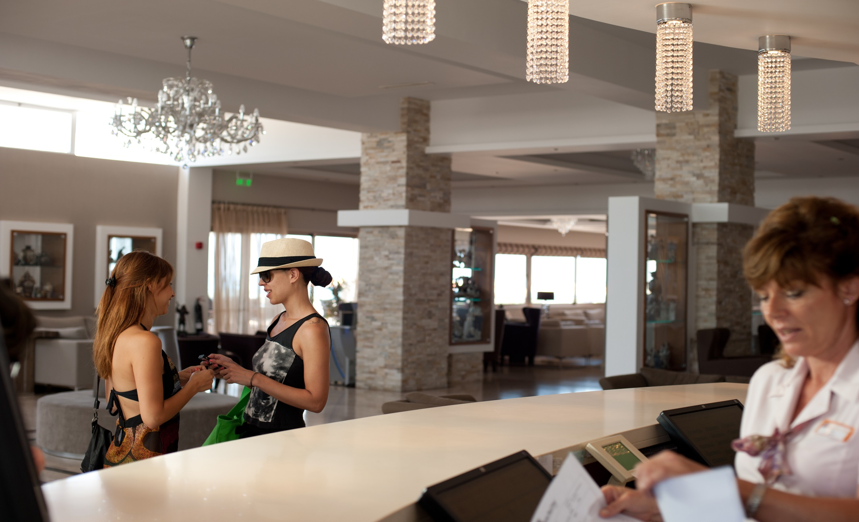
Reception/Lobby Area

Slide 18
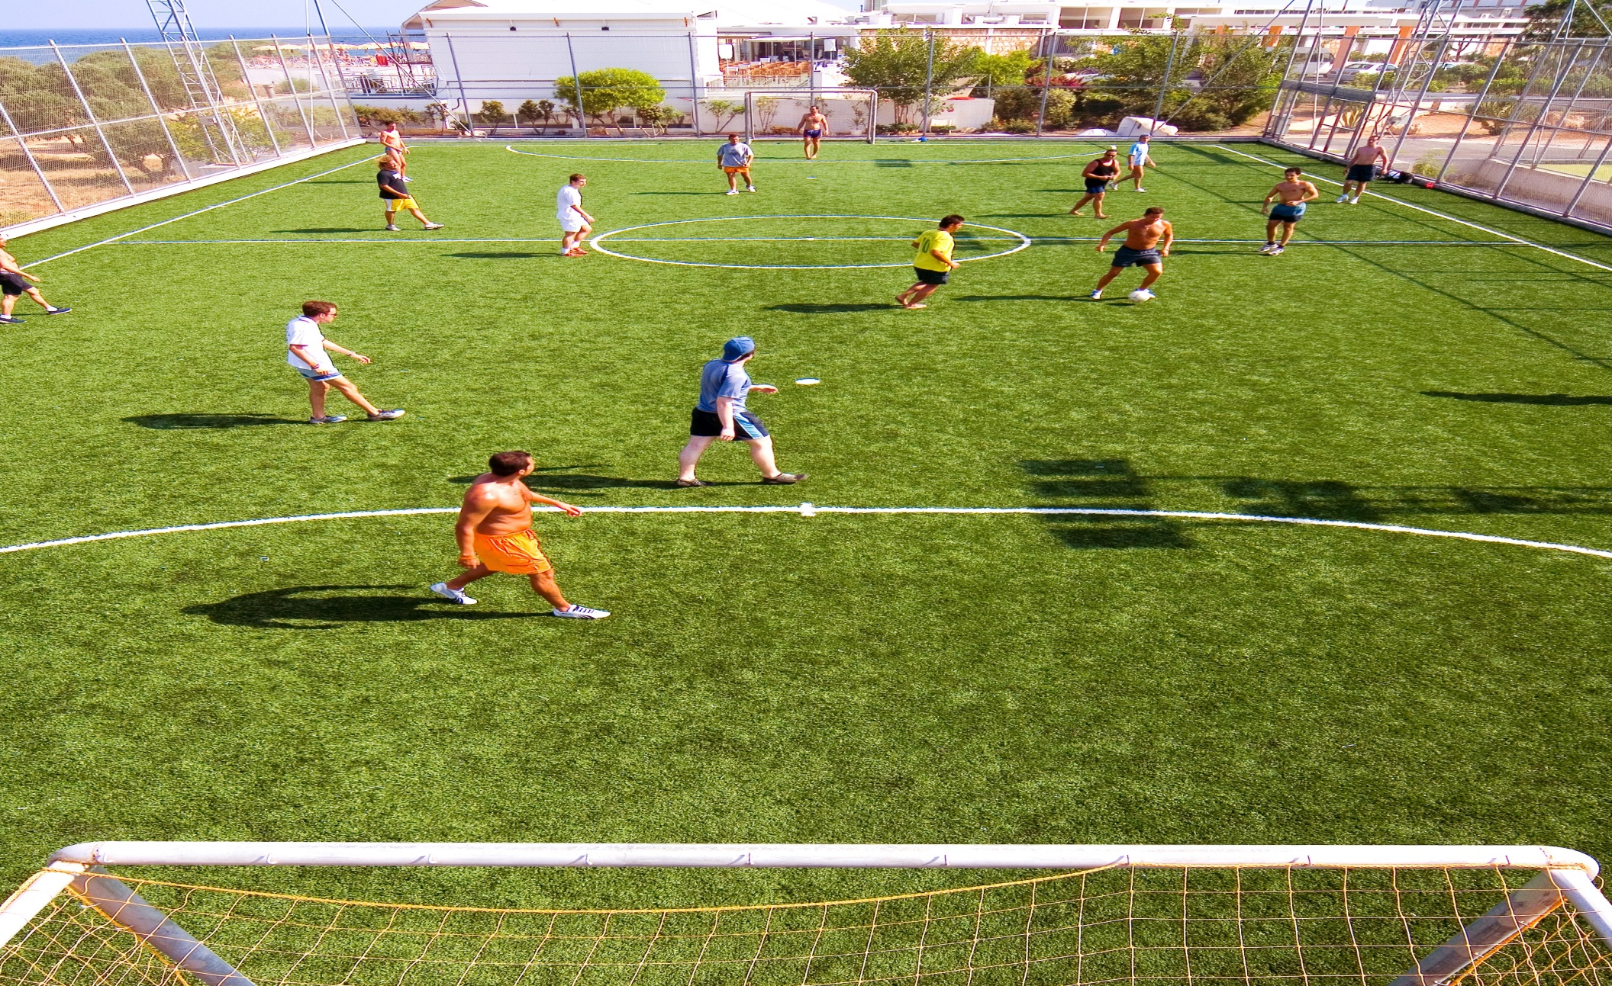
Animation Activities!

Slide 19
Why Work in Asterias?
To acquire experiences working in a successful hotel, that has been in business for more than 33 years and is one of the best hotels in Ayia Napa and Cyprus according to the guests ratings in www.holidaycheck.de, www.tripadvisor.com and www.booking.com.
Work in a professional and safe environment
Improve your foreign language skills

Slide 20
Why work in Asterias?
Future career opportunities
Do all that in our Island with a warm climate and while you are living few meters from white sandy beaches!
To travel in Cyprus and see our beautiful island!

Slide 21
Trainee Programs Opportunities
Trainees can work on a 6 days a week basis for 9hrs (including breaks for meals)
Airtickets compensation up to €250.00
Full Board for the duration of the stay (for all days)
Accommodation Included (free laundry service, electricity & water bills included as well)
Salary €450.00 Net per month

Slide 22
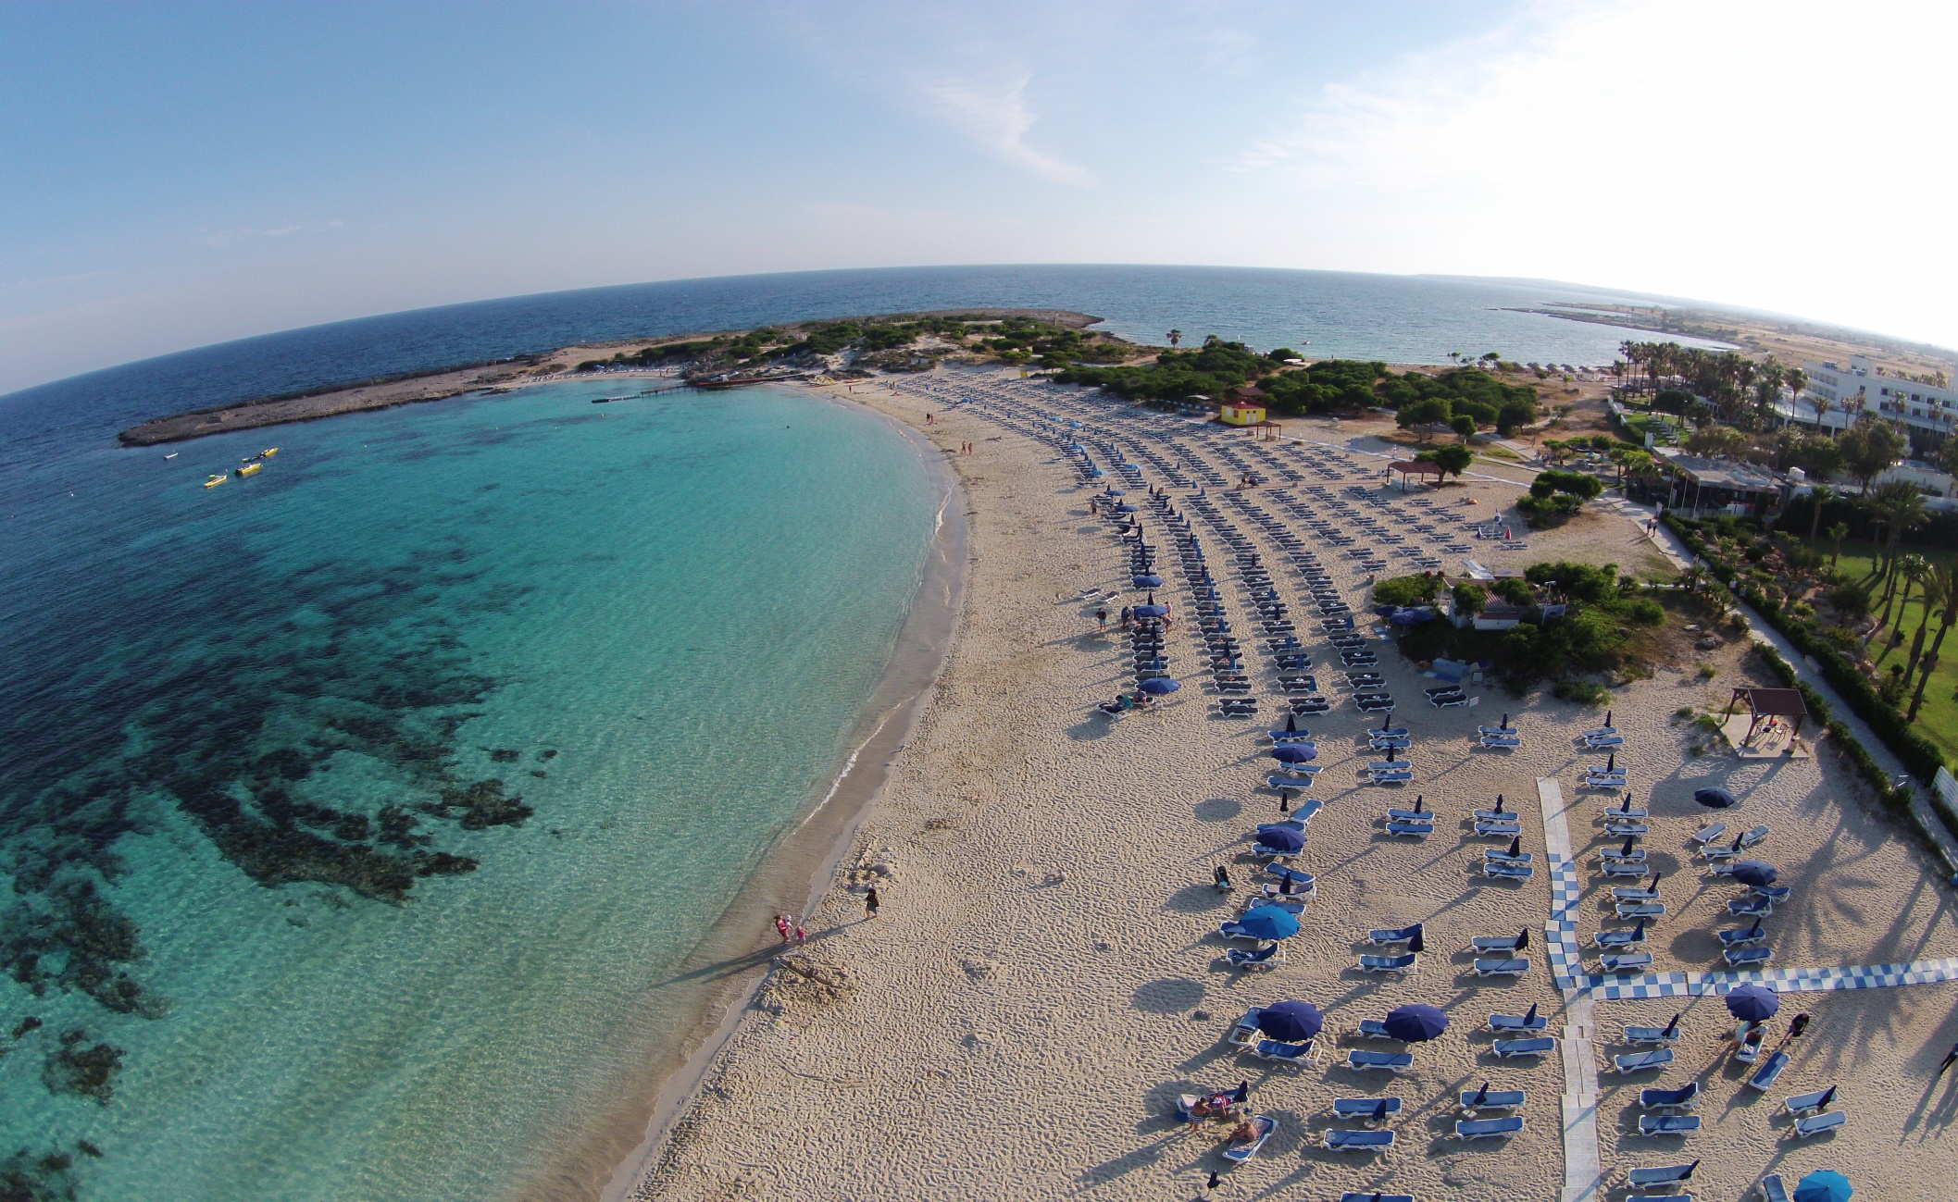
Any Questions?
THANK YOU!

