Slide 1
INTERNSHIP OPPORTUNITY WITH MK GROUP
A Gateway to Gaining Real-World Experience at Malta's Largest Resort

Slide 2
CONTENT
Introduction to Mk Malta Recruitment Agency
The Internship Opportunity
Key Benefits of the Internship
Why Our Client is the Best Choice
What We Expect from Our Interns
What You Will Gain
Examples
Location
Some of our clients

Slide 3
THE INTERNSHIP OPPORTUNITY
Why Join Our Internship Program?
Get practical, hands-on experience with Malta’s largest and best resort.
Work in a prestigious and dynamic environment that offers ample learning opportunities.
Gain insights into the hospitality industry and beyond.

Slide 4
KEY BENEFITS
Real-World Experience
Learn on the job in a leading resort, gaining relevant skills and knowledge in your field of study.
Networking Opportunities
Connect with industry leaders, professionals, and fellow interns.
Build a network that can lead to future career opportunities

Slide 5
Personal and Professional Growth
Strengthen your CV with practical experience.
Develop both soft and technical skills that employers highly value.
Mentorship and Guidance
Receive one-on-one mentoring from experienced professionals.
Grow and develop under the guidance of some of the best in the industry.

Slide 6
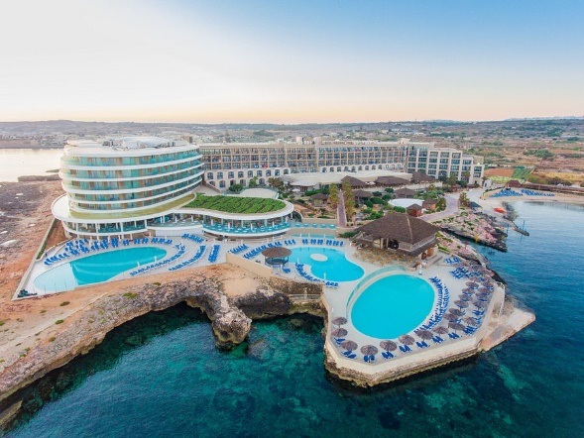
WHY OUR CLIENT IS THE BEST CHOICE
Largest Resort in Malta
Work with one of the most prestigious and largest resorts in the country.
Access top-tier facilities and world-class service standards
Reputation & Excellence
Our client is known for exceptional guest experiences and excellence in hospitality.
They offer a work culture that values talent, hard work, and development

Slide 7
WHAT WE EXPECT FROM OUR INTERNS
Passion & Enthusiasm
A genuine interest in the industry and the role.
Professionalism
Punctuality, dedication, and a positive attitude.
Adaptability
A genuine interest in the industry and the role.

Slide 8
WHAT YOU WILL GAIN
Hands-On Experience
Work with experienced teams and departments, from operations to guest services.
Increased Employability
Gain skills that are highly sought after in the global job market
Career Advancement
Possibility of full-time employment after the internship, based on performance.

Slide 9
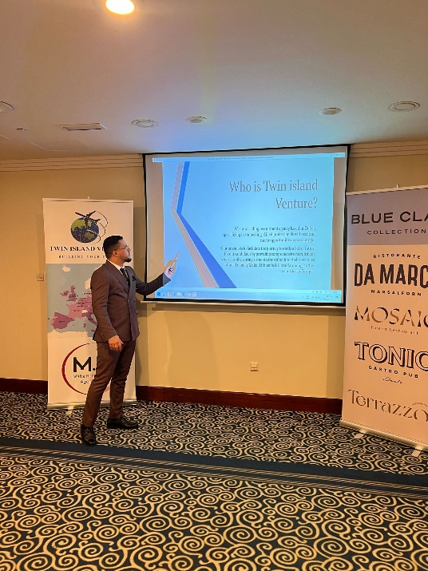
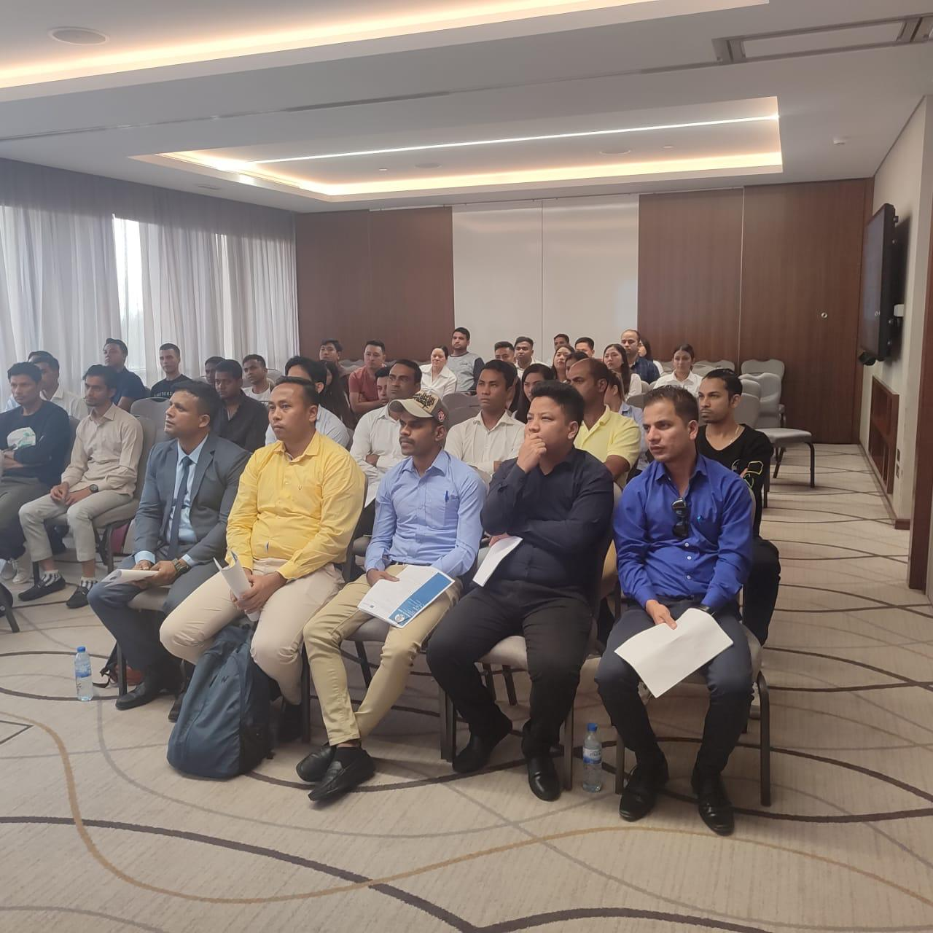
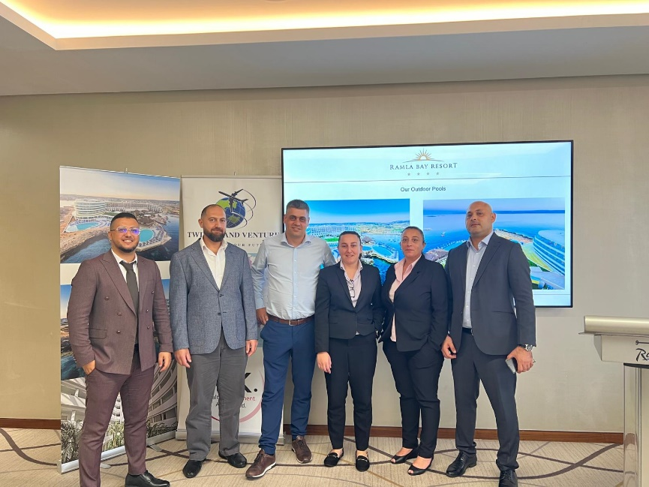
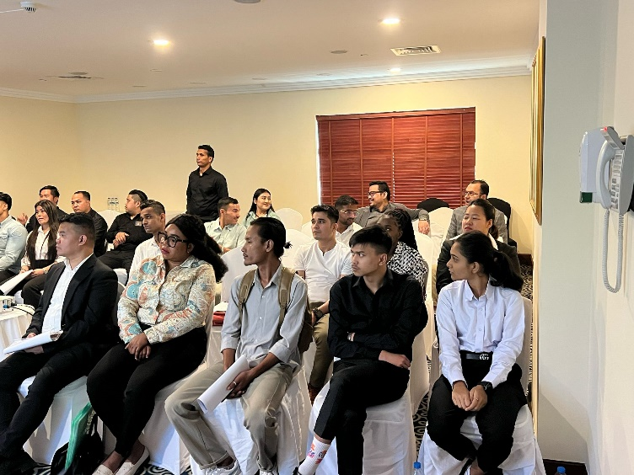
EXAMPLES

Slide 10
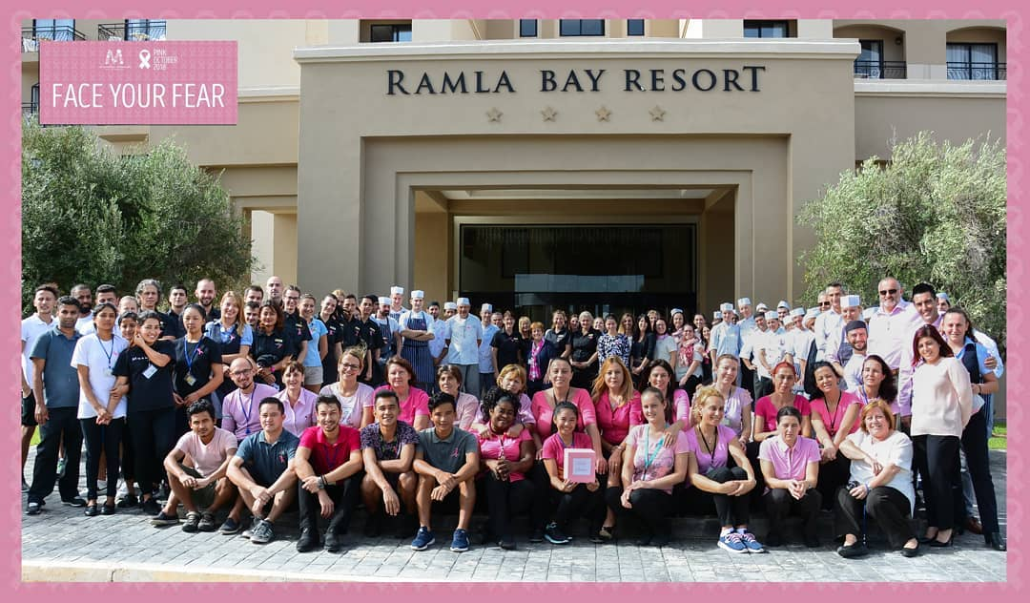
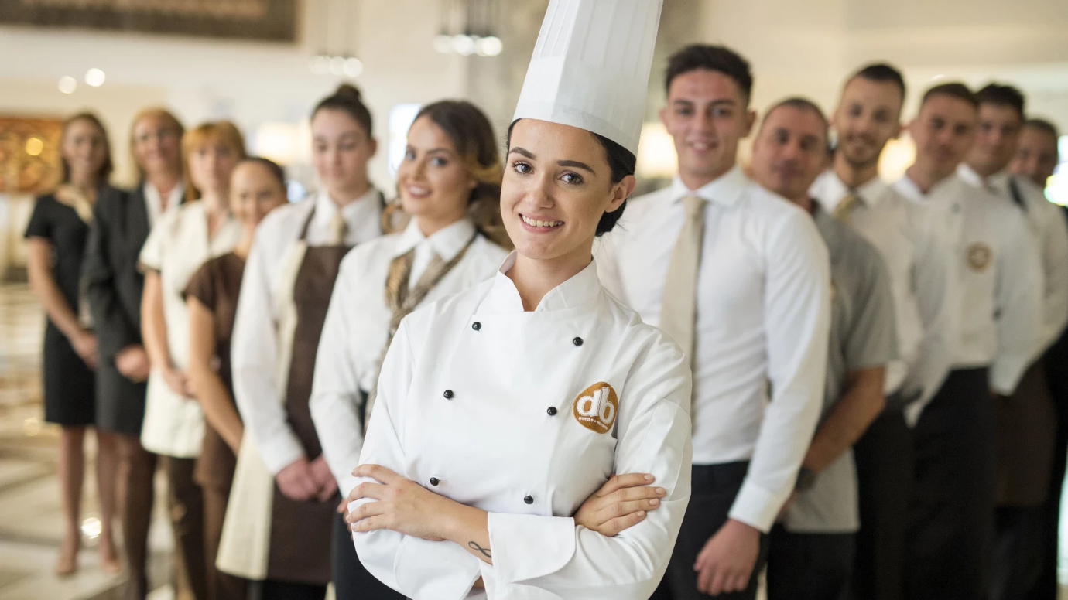
EXAMPLES

Slide 11
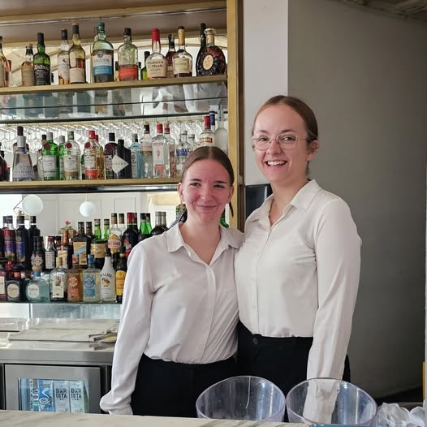
EXAMPLES

Slide 12
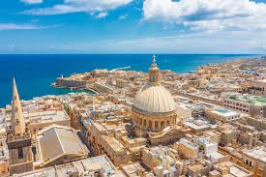
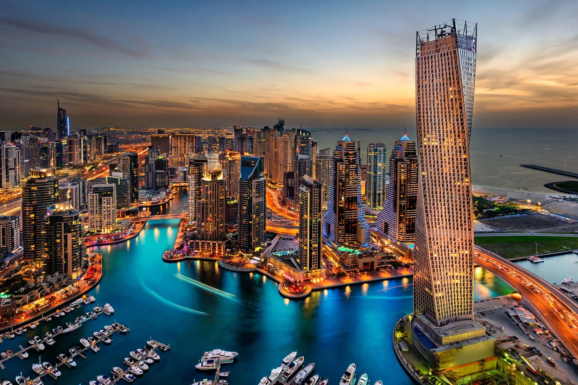
WHERE ARE WE LOCATED?
MALTA
DUBAI

Slide 13
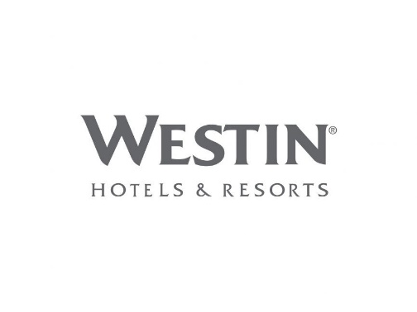
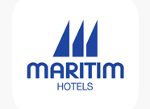
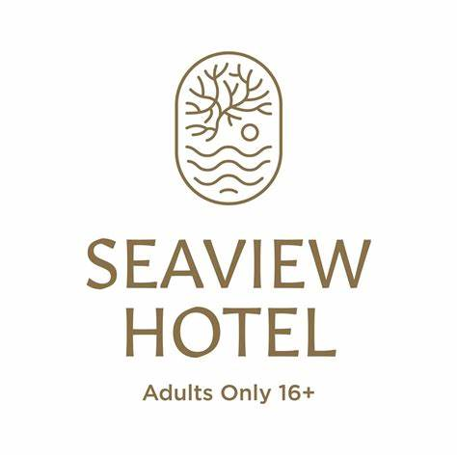
SOME OF OUR CLIENTS

Slide 14
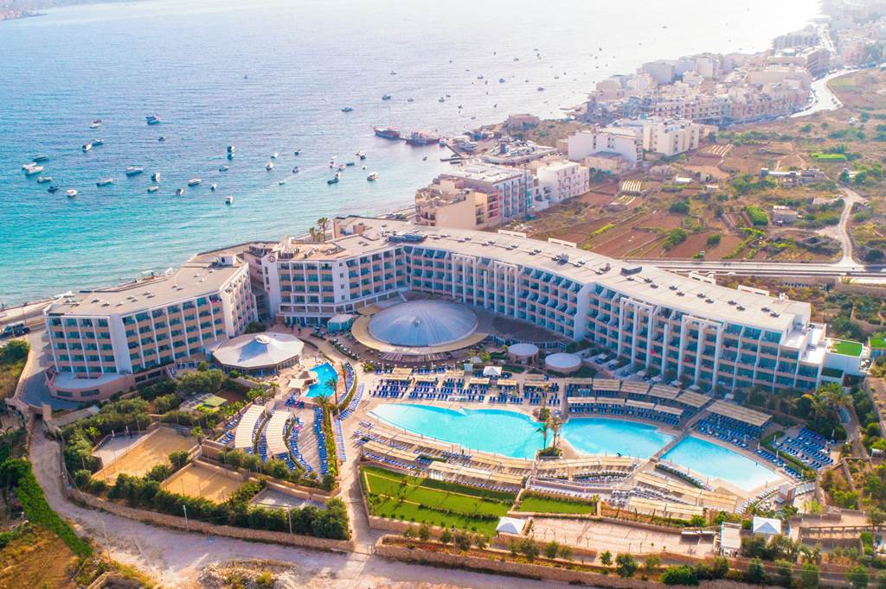
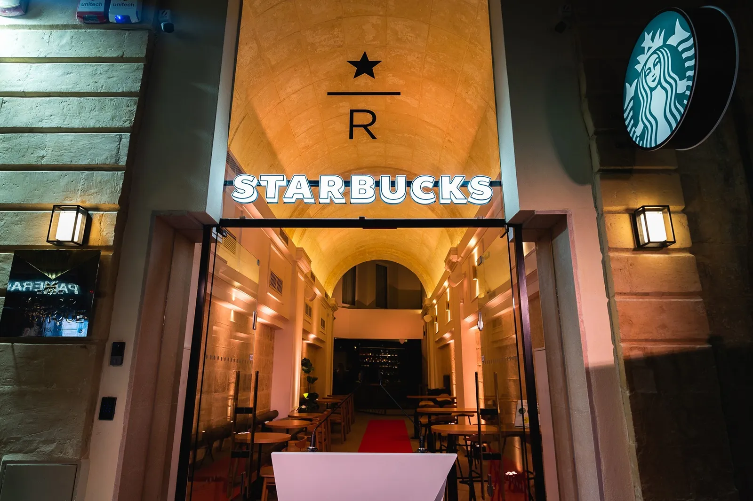
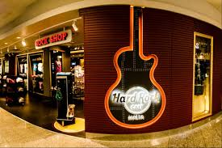
Starbucks
Ramla Bay Resort **** Deluxe
DB Seabank Resort & Spa ****
Hard Rock Cafe

Slide 15
THANK YOU FOR YOUR ATTENTION
EMAIL: HR@MKMALTAJOBS.COM
PHONE: +356 99771241
WEBSITE: HTTPS://WWW.MKMALTAJOBS.COM/

